Slide 1

CanSat 2019 Critical Design Review (CDR)
Netaji Subhas University of Technology
#3279
K.A.L.A.M.
Kinetic Autogyro Landing Aerospace Mission

Slide 2
Presentation Outline [1/6]
1. Team Organization
Mission Summary [ 11 - 12 ]
Summary of changes since PDR [13-14]
System Requirement Summary [15-18]
Payload Physical Layout [ 19-22 ]
System Concept of Operations [ 23 - 27 ]
Launch Vehicle Compatibility [ 28 - 29]
Sensor Subsystem Overview [ 31 ]
Sensor changes since PDR [32]
Sensor Subsystem Requirements [ 33 - 34 ]
Payload Air Pressure Sensor Trade & Selection [ 35-36 ]
Payload Air Temperature Sensor Trade & Selection [ 37 ]
GPS Sensor Trade & Selection [ 38-39]
Payload Power Voltage Sensor Trade & Selection [ 40 ]
Pitch/Roll Sensor Summary [41-42]
2. Acronyms
3. System Overview [10 - 29 ]
4. Sensor Subsystem Design [31-47]
Presenter: Ishita Kochar
Notes:
CanSat 2019 CDR: Team 3279 (Team KALAM)

Slide 3
Presentation Outline [2/6]
8. Auto-Gyro Blade spin rate sensor summary [43]
9. Bonus Camera objective Summary [44-45]
10. Container Air Pressure Sensor Summary [46-47]
Descent Control Overview [ 48 ]
Descent Control Changes Since PDR [49]
Descent Control Requirements [ 51 - 53 ]
Payload Descent Control Hardware Summary [ 54 - 56 ]
Payload Descent Stability Control Design [ 57 - 58 ]
Container Descent Control Hardware Summary [ 59 - 61 ]
Descent Rate Estimates [ 62 - 72 ]
Mechanical Subsystem Overview [ 74 - 75 ]
Mechanical Subsystem changes since PDR [76]
Mechanical Sub-System Requirements [ 77 - 78 ]
Payload Mechanical Layout of Components [ 79 - 84 ]
Container Mechanical Layout of Components [ 85 - 89 ]
Payload Release Mechanism [ 90 - 91 ]
Container Parachute Release Mechanism [ 92 ]
Structure Survivability [93]
Mass Budget [ 94- 101 ]
5. Descent Control Design [48 – 72 ]
6. Mechanical Subsystem Design [ 73 - 101]
Presenter: Ishita Kochar

Slide 4
Presentation Outline [3/6]
CDH Overview [ 103]
CDH Requirements [ 104 - 106 ]
Payload Processor & Memory Selection [ 107- 109]
Payload Real-Time Clock [ 110]
Payload Antenna Selection [ 111- 112]
Payload Radio Configuration [ 113-114]
Payload Telemetry Format [ 115]
Container Processor and Memory Selection [ 116 ]
EPS Overview [ 118-119]
EPS Changes since PDR [120]
EPS Requirements [ 121 - 122]
Payload Electrical Block Diagram [ 123]
Payload Power Source [ 124]
Payload Power Budget [ 125 - 126]
Container Electrical Block Diagram [ 127]
7. Communication and Data Handling (CDH) Subsystem Design [ 102- 116]
8. Electrical Power Subsystem (EPS) Design [ 117- 129]
Presenter: Ishita Kochar

Slide 5
Presentation Outline [4/6]
Container Power Source [ 128]
Container Power Budget [ 129 ]
FSW Overview [ 131 - 132 ]
FSW Requirements [ 133 - 134 ]
Payload FSW State Diagram [ 135- 136]
Container FSW State Diagram [ 137-138]
Software Development Plan [ 139 - 140 ]
GCS Overview [ 143]
GCS Changes since PDR[ 144]
GCS Requirements [ 145 - 146]
GCS Design [ 147 - 149 ]
GCS Software [ 150 - 152 ]
GCS Antenna Trade & Selection [ 153 - 157 ]
9. Flight Software (FSW) Design [ 130- 140]
10. Ground Control System (GCS) Design [ 141- 157 ]
Presenter: Ishita Kochar

Slide 6
Presentation Outline [5/6]
CanSat Integration and Test Overview [ 159]
Test Procedure Descriptions [161]
1. Overview of Mission Sequence of Events [184]
2. Field Safety Rules Compliance [187]
3. CanSat Location and Recovery [189]
4. Mission Rehearsal Activities [190]
Requirements Compliance Overview [ 192]
Requirements Compliance [ 193 - 197 ]
Status of Procurements [199-200]
CanSat Budget – Hardware [ 201 - 205 ]
CanSat Budget – Other Costs [ 206 - 209 ]
Detailed Program Schedule [ 210 - 214]
Shipping and transportation [215-216]
Conclusions [ 217 - 219 ]
11. CanSat Integration and Test [ 159 - 182]
12. Mission Operations and Analysis [ 184 - 190 ]
13. Requirements Compliance [ 192 - 197]
14. Management [ 199-219 ]
Presenter: Ishita Kochar

Slide 7
Presentation Outline [6/6]
Section | Presenter
Systems Overview | Sanuj Kulshrestha
Sensor Subsystem Design | Sumiran Bhasin
Descent Control Design | Aayush Aggarwal
Mechanical Subsystem Design | Arham Jain
Communication and Data Handling (CDH) Subsystem Design | Ishita Kochar
Electrical Power Subsystem (EPS) Design | Anmol Gulati
Flight Software (FSW) Design | Rishabh Yadav
Ground Control System (GCS) Design | Vineet Khurana
CanSat Integration and Test | Bhavuk Grover
Mission Operations & Analysis | Gaurav Verma
Requirements Compliance | Gaurav Verma
Management | Vineet Khurana
Presenter: Ishita Kochar

Slide 8
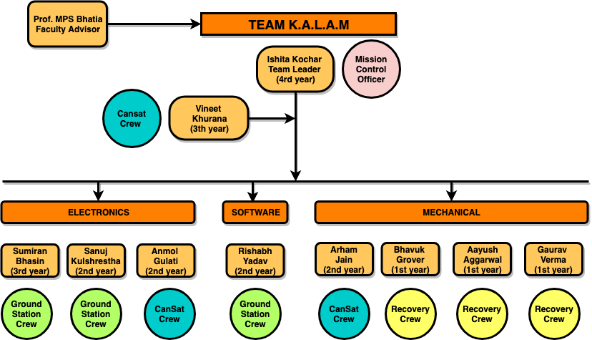
Team Organization
Presenter: Ishita Kochar

Slide 9
Acronyms
A | Analysis
ADC | Analog to Digital Converter
Alt | Altitude
ARM | Advanced RISC Machines
CDH | Communication and Data Handling
CDR | Critical Design Review
CONOPS | Concept of Operations
DCR | Decent Control Requirements
D | Demonstration
EEPROM | Electrically Erasable Programmable Read Only Memory
EPS | Energy Power Subsystem
FSW | Flight Software
GCS | Ground control station
GPS | Global Positioning System
GUI | Graphical User Interface
HDPE | High Density Polyethylene
I | Inspection
I2C | Inter-Integrated Circuit (Two Wire Interface)
IDE | Integrated Development Environment
Li | Lithium
MCU | Microcontroller Unit
MSR | Mechanical Sub-System Requirements
P | Process
PANID | Personal Area Network Identification Number
VM | Verification Method
SR | System Requirements
T | Testing
Presenter: Ishita Kochar

Slide 10
System Overview
Sanuj Kulshrestha

Slide 11
Mission Summary [1/2]
Objectives
Build a CanSat that will use auto-gyro/passive helicopter recovery descent control of a science payload when released from the launch vehicle.
The CanSat shall be launched to an altitude ranging 670 -725 meters above the launch site.
Once the CanSat is deployed from the rocket, the CanSat shall descend using a parachute at a descent rate of 20 m/s.
At 450 meters, the container shall release the science payload.
The descent rate of science payload shall be 10 to 15 m/s.
The science payload descends under auto-gyro/passive helicopter recovery control system.
The payload shall transmit telemetry which shall include sensors to track altitude using air pressure, external temperature, battery voltage, GPS position, pitch and roll and blade spin rate
The Ground Control Station shall receive and display CanSat data.
When the science payload lands, all telemetry transmission shall stop and a located audio beacon shall activate.
Presenter: Sanuj Kulshrestha

Slide 12
Mission Summary [2/2]
Bonus Objective
A video camera shall be integrated into the science payload to record the descent after being released from the container.
Video shall be in color with a minimum resolution of 640x480 pixels and 30 frames per second.
The camera shall point downward 45 degrees from nadir of the science payload.
It shall point in one direction relative to the earth’s magnetic field with a stability of +/- 10 degrees in all directions during descent.
Telemetry shall include the direction of camera that is relative to earth's magnetic north.
Funding for project’s hardware and logistical needs through potential sponsors.
We have already conducted workshops in our home city and we are planning to conduct CanSat-related workshops at the national scale.
External Objectives
Presenter: Sanuj Kulshrestha

Slide 13
Summary of Changes Since PDR
Sensor Subsystem Changes
GPS BN220 has been replaced by GPS-NEO 6M.
Descent Control Subsystem Changes
There have been no changes in Descent Control Subsystem since PDR.
Mechanical Subsystem Changes
Payload design has been modified.
Communication and Data Handling Subsystem Changes
There have been no changes in Communication and Data Handling Subsystem since PDR
Presenter: Sanuj Kulshrestha

Slide 14
Summary of Changes Since PDR
Electrical Power Subsystem Changes
A 9V – 12V booster has been used to power the buzzer so as to obtain a sound rated 100dB intensity.
The container battery bas been updated to EBL Li-ion Battery as it performs equally well in low as well as in high rate of discharge
Flight Software Changes
There have been no changes in the FSW since the PDR
Ground Control Station Changes
There have been no changes in Ground Control Station since PDR
Presenter: Sanuj Kulshrestha

Slide 15
System Requirement Summary [1/4]
SRS# | Description | VM
 |  | A | I | T | D
SRS1 | Total mass of CanSat (science payload and container) shall be 500grams +/- 10 grams | ✔️ | ✔️ | ✔️ | ✔️
SRS2 | CanSat shall fit in a cylindrical envelope of 125 mm diameter x 310 mm length. Tolerances are to be included to facilitate container deployment from the rocket fairing. | ✔️ | ✔️ | ✔️ | ✔️
SRS3 | The container shall not have any sharp edges to cause it to get stuck in the rocket payload section which is made of cardboard. | ✔️ | ✔️ |  | ✔️
SRS4 | The container shall be a fluorescent color; pink, red or orange. | ✔️ | ✔️ | ✔️ | ✔️
SRS5 | The rocket airframe shall not be used as part of the CanSat operations. |  | ✔️
SRS6 | The CanSat shall deploy from the rocket payload section and immediately deploy the container parachute. |  | ✔️
SRS7 | The descent rate of the CanSat (container and science payload) shall be 20 meters/second +/- 5m/s. |  |  |  | ✔️
SRS8 | The container shall release the payload at 450 meters +/- 10 meters. | ✔️ | ✔️ | ✔️ | ✔️
SRS9 | The science payload shall descend using an auto-gyro/ passive helicopter recovery descent control system. |  |  | ✔️ | ✔️
SRS10 | The descent rate of the science payload after being released from the container shall be 10 to 15 meters/second. |  |  | ✔️ | ✔️
Presenter: Sanuj Kulshrestha

Slide 16
System Requirement Summary [2/4]
SRS# | Description | Verification Method
 |  | A | I | T | D
SRS11 | All descent control device attachment components shall survive 30 Gs of shock. |  | ✔️ | ✔️
SRS12 | All electronics shall be hard mounted using proper mounts such as standoffs, screws, or high performance adhesives. | ✔️ | ✔️
SRS13 | The science payload shall measure altitude using an air pressure sensor. |  | ✔️ | ✔️ | ✔️
SRS14 | The science payload shall provide position using GPS. |  | ✔️ | ✔️ | ✔️
SRS15 | The science payload shall measure its battery voltage. |  | ✔️ | ✔️ | ✔️
SRS16 | The science payload shall measure outside temperature. |  | ✔️ | ✔️ | ✔️
SRS17 | The science payload shall measure the spin rate of the auto-gyro blades relative to the science vehicle. | ✔️ | ✔️ | ✔️ | ✔️
SRS18 | The science payload shall measure pitch and roll. |  | ✔️ | ✔️ | ✔️
SRS19 | The payload shall transmit all sensor data in the telemetry |  | ✔️ | ✔️ | ✔️
SRS20 | The Parachute shall be fluorescent Pink or Orange |  | ✔️
SRS21 | The ground station shall be able to command the science vehicle to calibrate barometric altitude, and roll and pitch angles to zero as the payload sits on the launch pad. | ✔️ | ✔️ | ✔️ | ✔️
Presenter: Sanuj Kulshrestha

Slide 17
System Requirement Summary [3/4]
SRS# | Description | Verification Method
 |  | A | I | T | D
SRS22 | Telemetry shall include mission time with one second or better resolution. Mission time shall be maintained in the event of a processor reset during the launch and mission. | ✔️ | ✔️ | ✔️ | ✔️
SRS23 | XBEE radios shall be used for telemetry. 2.4 GHz Series radios are allowed. 900 MHz XBEE Pro radios are also allowed. | ✔️ | ✔️ | ✔️ | ✔️
SRS24 | Cost of the CanSat shall be under $1000. Ground support and analysis tools are not included in the cost. | ✔️ | ✔️
SRS25 | Teams shall plot each telemetry data field in real time during flight. | ✔️ | ✔️ | ✔️
SRS26 | The flight software shall maintain a count of packets transmitted, which shall increment with each packet transmission throughout the mission. The value shall be maintained through processor resets. |  | ✔️ | ✔️ | ✔️
SRS27 | No lasers allowed. |  | ✔️
SRS28 | The payload must include an easily accessible power switch that can be accessed without disassembling the CanSat and in the stowed configuration | ✔️ | ✔️ |  | ✔️
SRS29 | The payload must include a power indicator such as an LED or sound generating device that can be easily seen without disassembling the CanSat and in the stowed state. |  | ✔️ |  | ✔️
Presenter: Sanuj Kulshrestha

Slide 18
System Requirement Summary [4/4]
SRS# | Description | Verification Method
 |  | A | I | T | D
SRS30 | The audio beacon must have a minimum sound pressure level of 92 dB, unobstructed. |  | ✔️ | ✔️ | ✔️
SRS31 | Battery source may be alkaline, Ni-Cad, Ni-MH or Lithium. Lithium polymer batteries are not allowed. Lithium cells must be manufactured with a metal package similar to 18650 cells. |  | ✔️ | ✔️
SRS32 | Spring contacts shall not be used for making electrical connections to batteries. Shock forces can cause momentary disconnects. | ✔️ | ✔️ |  | ✔️
SRS33 | The auto-gyro descent control shall not be motorized. It must passively rotate during descent. | ✔️ | ✔️
SRS34 | The GPS receiver must use the NMEA 0183 GGA message format. | ✔️ | ✔️ | ✔️
SRS35 | Payload/Container shall operate for a minimum of two hours when integrated into rocket |  | ✔️ |  | ✔️
BONUS | A video camera shall be integrated into science payload to record descent after being release from container. Camera must be color with a minimum resolution of 640x480 pixels and 30 frames per second. The camera shall point downward 45 degrees from nadir of the science payload. | ✔️ | ✔️ | ✔️
Presenter: Sanuj Kulshrestha

Slide 19
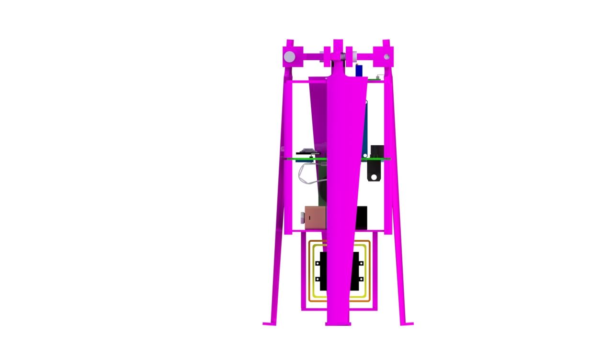
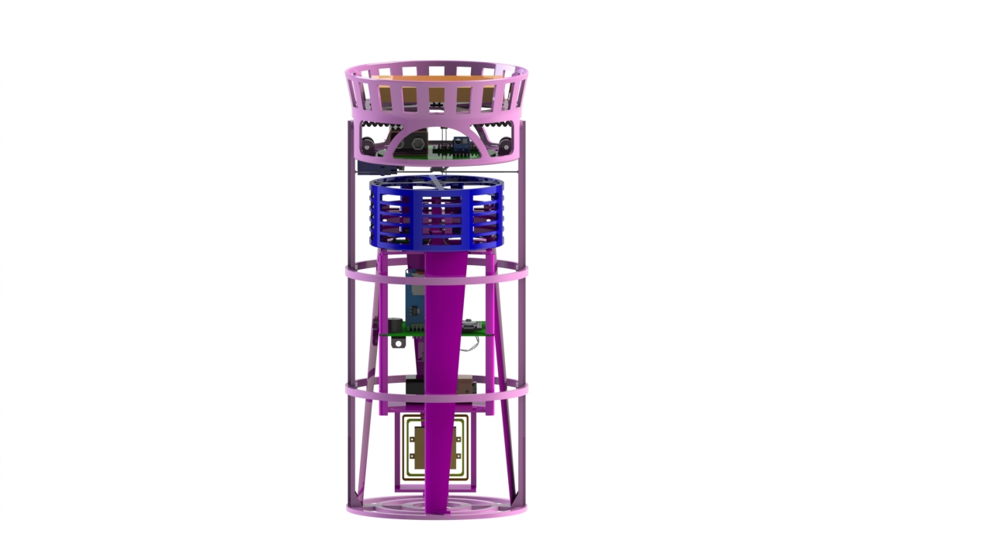
Payload Physical Layout [1/4]
CanSat
Payload
Presenter: Sanuj Kulshrestha

Slide 20
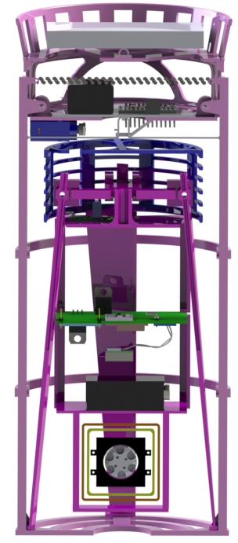
Payload Physical Layout [2/4]
A
Dimensioning
B
Symbol | Components | Dimensions
A | Parachute | Radius=55mm
B | Spring | Diameter=4mm , Length=115mm
C | Servo Motor | LengthxWidthxHeight = 31x24x12mm
D | Cage | Diameter=90mm , Height=51mm
E | Container Ribs | Diameter=110mm , Height=297.8mm
F | Blade | LengthxWidthxHeight = 207x30x3mm
G | Electronic Component | LengthxWidthxHeight = 75x75x110mm
H | Camera Stabilizer (Gimbal) | LengthxWidthxHeight =45x41x32mm
C
D
E
F
G
H
Presenter: Sanuj Kulshrestha

Slide 21
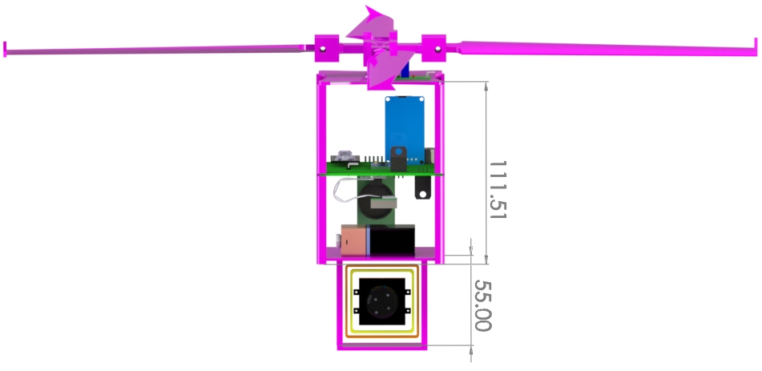
Payload Physical Layout [3/4]
Payload Dimensioning
Electronics Compartment
Gimbal
(Camera stabilization)
Presenter: Sanuj Kulshrestha

Slide 22
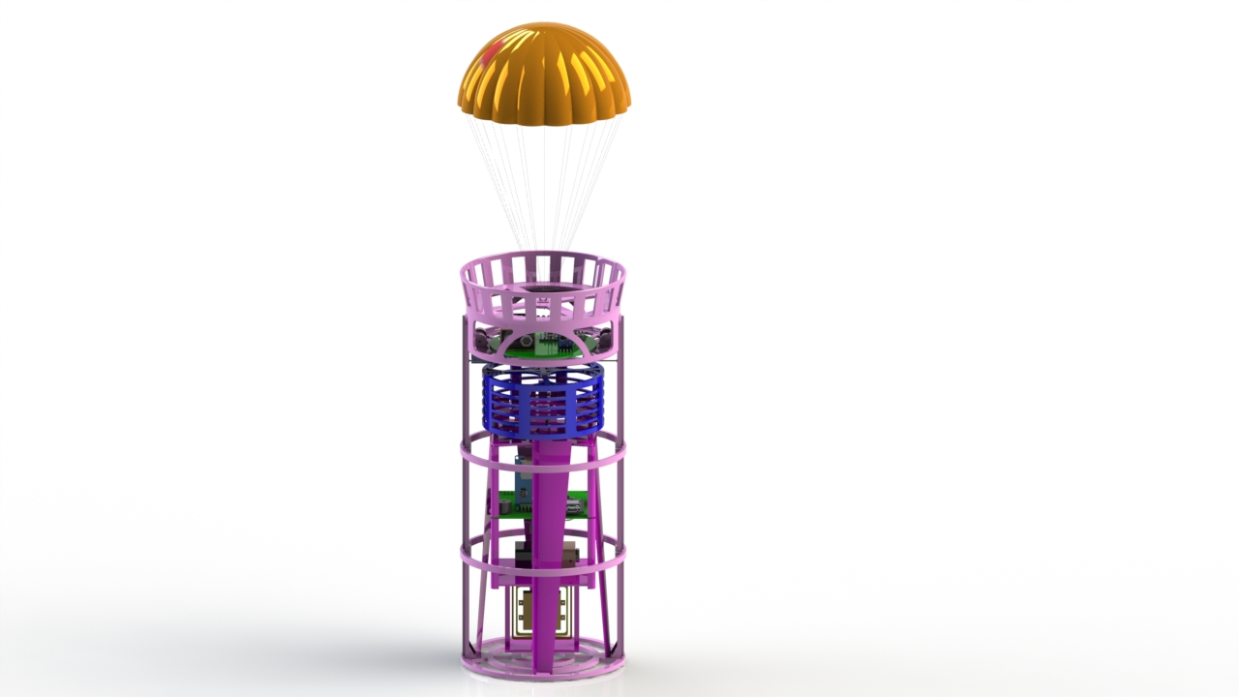
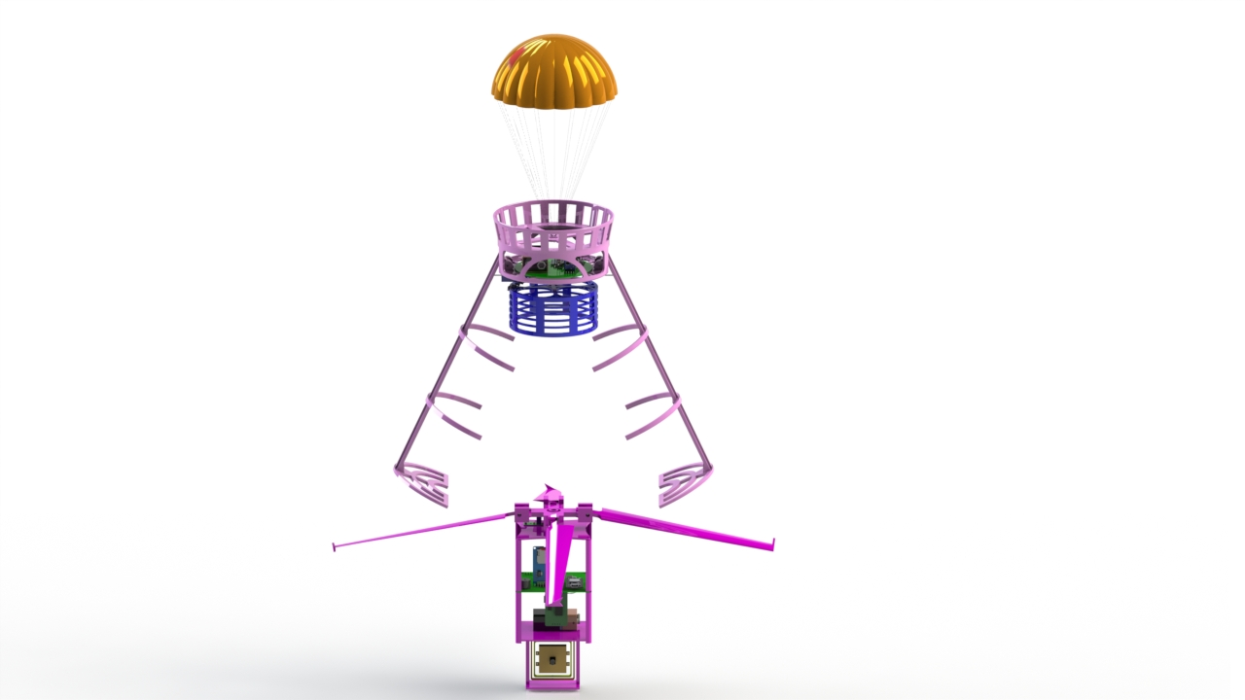
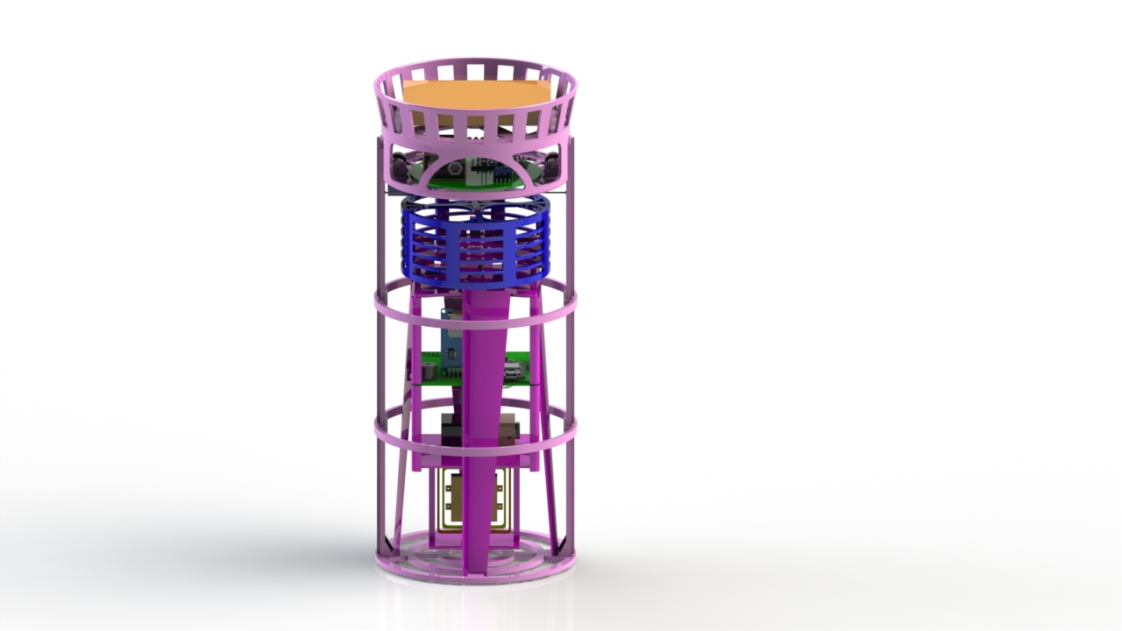
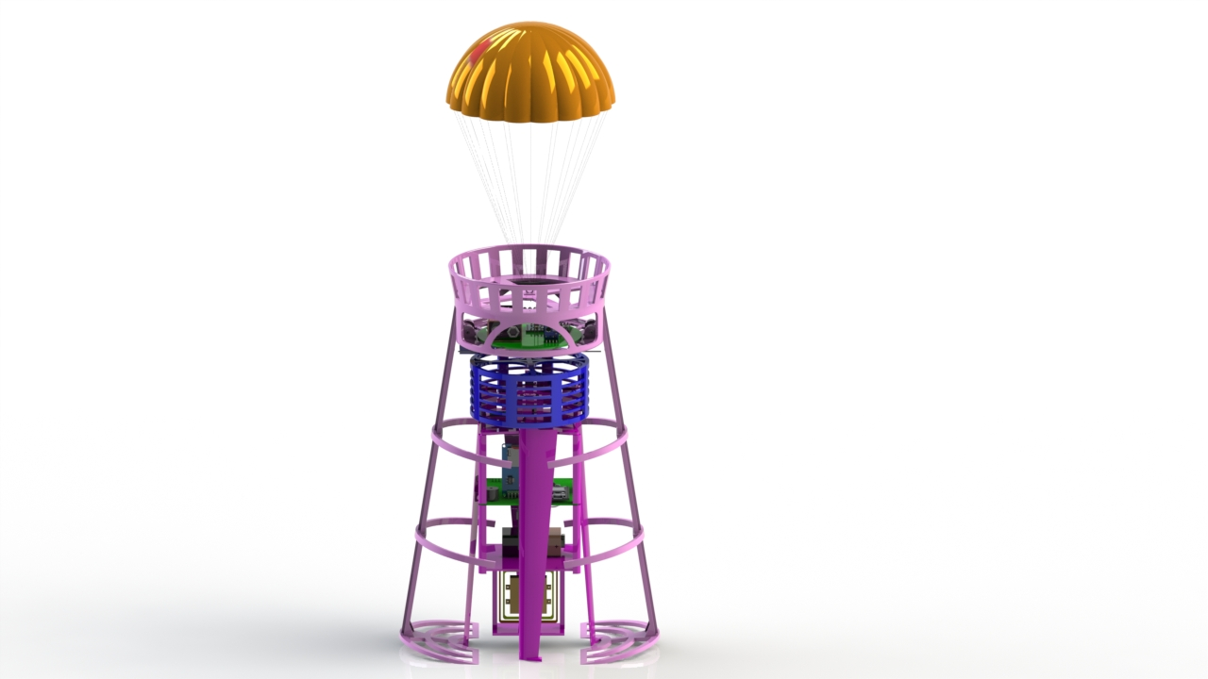
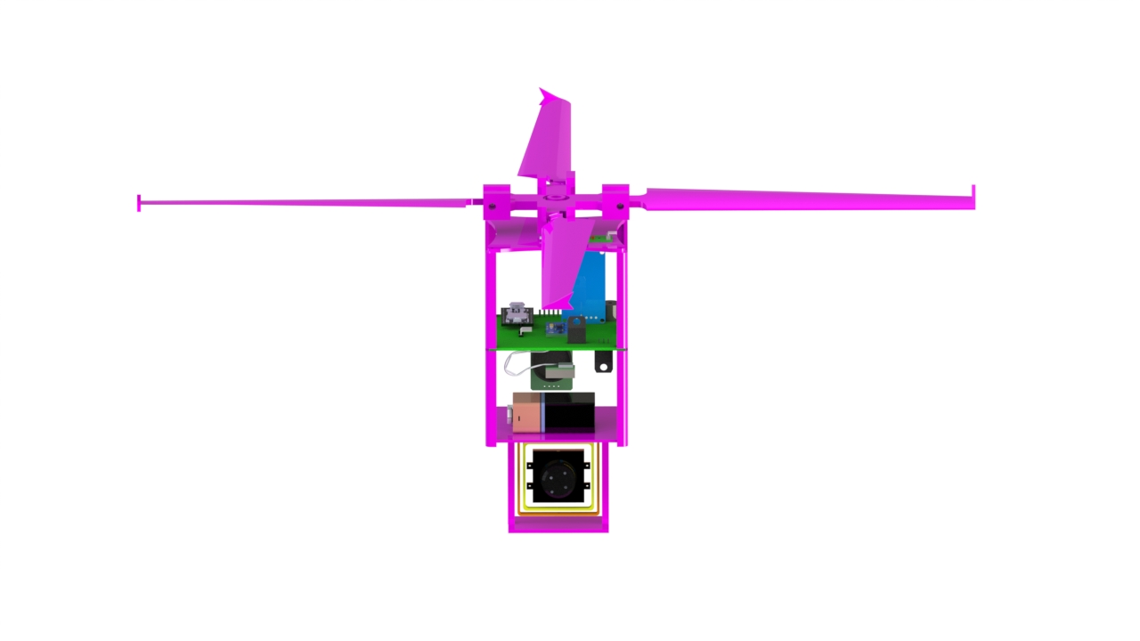
Payload Physical Layout [4/4]
4.Payload
Release
2. Parachute Deployment
1. Launch
Configuration
5. Payload Deployment
3. Container Opening
Presenter: Sanuj Kulshrestha

Slide 23
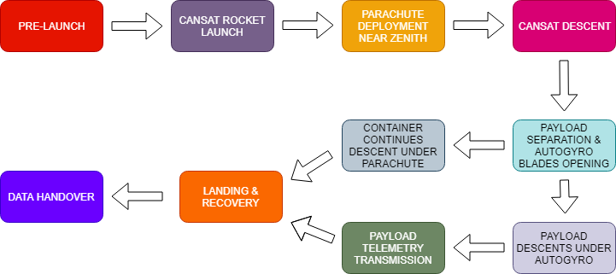
System Concept of Operations [1/5]
Name | Role/Responsibility
Ishita Kochar | Mission Control Officer
Vineet Khurana | CanSat Crew
Arham Jain | CanSat Crew
Anmol Gulati | CanSat Crew
Sanuj Kulshrestha | Ground Station Crew
Rishabh Yadav | Ground Station Crew
Sumiran Bhasin | Ground Station Crew
Bhavuk Grover | Recovery Crew
Gaurav Verma | Recovery Crew
Aayush Aggarwal | Recovery Crew
Presenter: Sanuj Kulshrestha

Slide 24
System Concept of Operations [2/5]
Pre-Launch
1. The CanSat integrity as a whole is checked thoroughly.
2. Environmental tests performed by the staff.
3. Communication and GCS checks completed.
4. CanSat is switched ON, and telemetry starts.
5. CanSat integrated in the launch rocket.
1. CanSat launched with the rocket.
1. CanSat released at apex at an altitude of around 700m. 2. The parachute of CanSat deploys right after the release.
Launch
CanSat Release & Parachute Deployment
Presenter: Sanuj Kulshrestha

Slide 25
System Concept of Operations [3/5]
CanSat Descent
1. The CanSat descents under parachute with velocity of 20 $± 5$m/s.
1. The CanSat descents under parachute with velocity of 20 ± 𝟓 m/s.
1. At the altitude of 450m, the servo motor cuts the Kevlar thread. 2. The stretched/stressed spring gets compressed and pulls the container ribs open. 3. The payload slips down the container. 4. The stowed autogyro blades are deployed.
1. The autogyro blades start rotating. 2. The payload descent under autogyro with velocity of 10m/s.
Payload Separation & Autogyro Blade Opening
Payload Descent under Autogyro
Presenter: Sanuj Kulshrestha

Slide 26
System Concept of Operations [4/5]
Container Descent
1. The container continues descent under the parachute.
1. The audio beacon on both container and payload starts after landing. 2. The telemetry transmission stops. 3. The last GPS location of payload is used to narrow down the location. 4. Bright pink colour on both payload and container for easy detection during landing.
1. The .csv file is copied to the thumb drive and handed over.. 2. PFR preparations are started.
Landing & Recovery
Data Handover & PFR
Presenter: Sanuj Kulshrestha

Slide 27
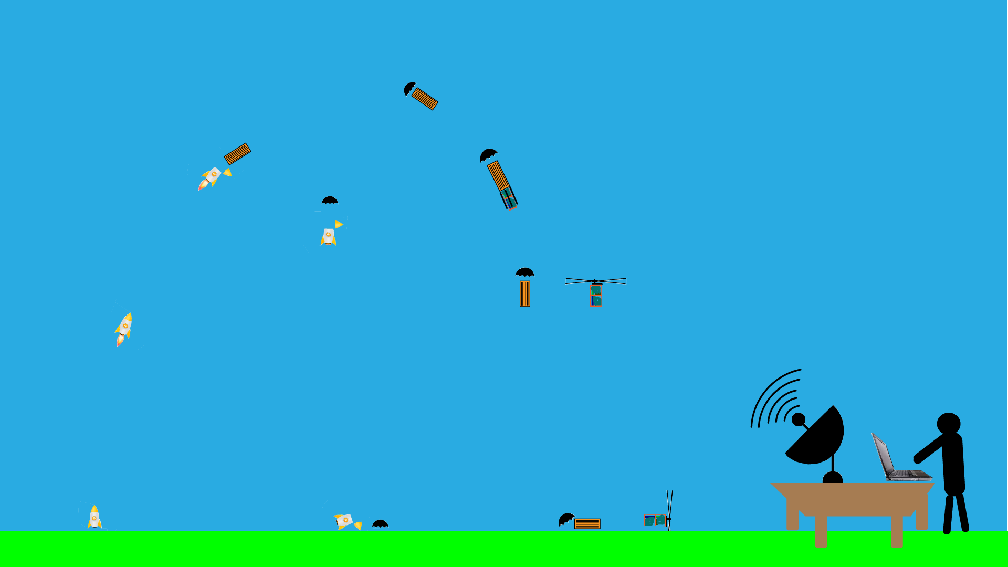
System Concept of Operations [5/5]
Presenter: Sanuj Kulshrestha

Slide 28
Launch Vehicle Compatibility [1/2]
Available Volume (as per Competition Requirements):
Diameter 125 mm
Height 310 mm
Diameter 115 mm
Height 295 mm
10mm in diameter
15mm in Height
Available Volume (as per Competition Requirements):
CanSat Volume:
Clearance:
Presenter: Sanuj Kulshrestha

Slide 29
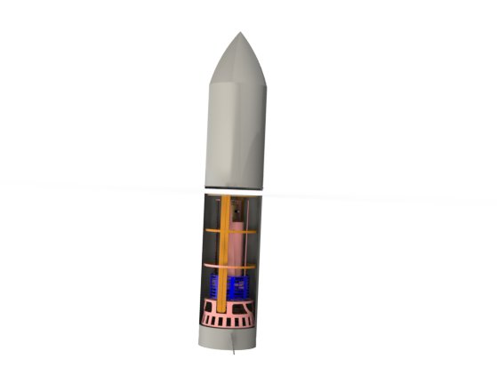
Launch Vehicle Compatibility [2/2]
15mm clearance for payload
310mm(Rocket)
125mm(Rocket)
5mm clearance for payload on both sides
No sharp protrusions
Presenter: Sanuj Kulshrestha

Slide 30
Sensor Subsystem Design
Sumiran Bhasin

Slide 31
Sensor Subsystem Overview
Where? | S.No. | Sensor | Device Name and its Model | How are they used?
Payload | 1 | Air Pressure Sensor | BMP-180 | BMP-180 is used to measure pressure and temperature. We are using it to get the altitude of payload.
Payload | 2 | Pitch and Roll Sensor | MPU-6050 | MPU-6050 is used to obtain acceleration and angular velocity in x, y and z axis. It gives pitch and roll of the Payload
Payload | 3 | GPS | UBLOX NEO 6M | Gives the time, latitude, longitude, altitude, number of Satellite.
Payload | 4 | Temp. Sensor | BMP-180 | We are using it to get the temperature of the payload.
Payload | 5 | Auto-Gyro blade spin Sensor | Hall Sensor (AH44E Hall Effect Switch) | It detects Magnetic field of magnets on blade that is used to calculate the RPM of blades.
Payload | 6 | Voltage | Resistors | Voltage divider circuit to map actual voltage on ADC of Teensy. It Gives Battery Voltage
Payload | 7 | Camera Sensor | Turbowing Cyclops DVR 3 | It is used for bonus task. Camera will start recording video at 640x480 30fps when payload is released from Container.
Container | 8 | Air Pressure Sensor | BMP-180 | BMP-180 is used to measure pressure and temperature. We are using it to get the altitude of container.
Presenter: Sumiran Bhasin

Slide 32
Sensor Changes Since PDR
Serial Number | Sensor Filed | From (In PDR) | To (In CDR) | Rationale
1. | GPS Sensor | BN220 | UBLOX NEO-6M | Non-availabily of BN220 in Indian Market. The actual cost and overseas shipping charges would have increased the cost. UBLOX NEO-6M, most common GPS in Indian was tested and hence used. There are no technical reasons to switch to UBLOX NEO-6M
Presenter: Sumiran Bhasin

Slide 33
Sensor Subsystem Requirements [1/2]
ID | Requirement | Rationale | Parent | Priority | Verification Method
 |  |  |  |  | A | I | T | D
SS-1 | The payload shall measure air pressure, air temperature, altitude, pitch, roll, GPS position, battery voltage, mission time spin rate of auto-gyro blades during its descent through use of various sensors. | Competition Requirement | BR-20, BR-21, BR-22, BR-23, BR-24, BR-25 | Very high | ✔️ | ✔️ | ✔️
SS-2 | All the sensor data shall be transmitted through telemetry to the ground station. | Competition Requirement | BR- 26 PCDH-01 | Very high | ✔️ |  | ✔️
SS- 3 | The sensor data shall also be stored in SD card for backup. | Competition Requirement |  | High | ✔️
Presenter: Sumiran Bhasin

Slide 34
Sensor Subsystem Requirements [2/2]
ID | Requirement | Rationale | Parent | Priority | Verification Method
 |  |  |  |  | A | I | T | D
SS-4 | The GPS sensor shall use NMEA 0183 GGA format | Competition Requirement | BR- 53 | Very high | ✔️ | ✔️ | ✔️
SS- 5 | The payload shall record its descent through a video camera integrated in it. | Bonus Objective |  | High | ✔️ |  | ✔️
SS- 6 | The camera shall point 45 degrees from nadir. Also, the camera shall point in one direction from the earth’s magnetic field with stability of 10 degrees in either direction. The direction from magnetic north shall be included in telemetry. | Bonus Objective |  | High | ✔️ | ✔️
Presenter: Sumiran Bhasin

Slide 35
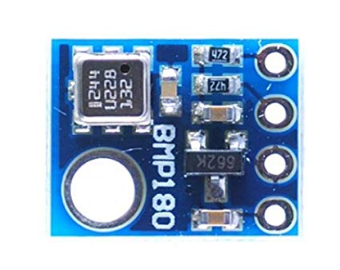
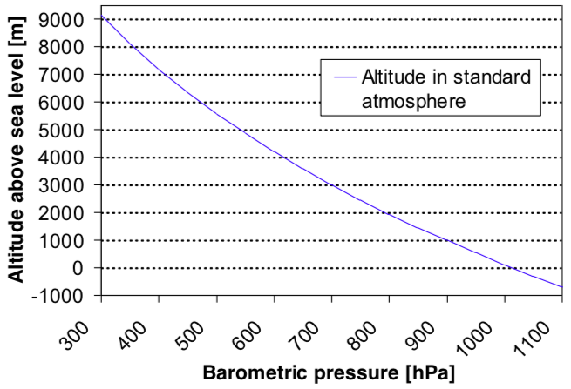
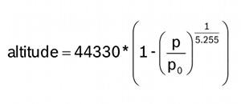
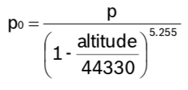
Payload Air Pressure Sensor Summary
Sensor Selected :
BMP180
Source: Datasheet
Characteristics
Low power: 5µA at 1 sample / sec. in standard mode
Low noise: 0.06hPa (0.5m) in ultra low power mode 0.02hPa (0.17m) advanced resolution mode.
Resolution of 0.01hPa.
Inter-face | Pressure Range (hPa) | Dimensions (mm) | Weight (g) | Working Current (mA) | Sensitivity (hPa) | Operating Voltage (V)
I2C | 300-1100 | 14 x 12 x 0.93 | 0.92 | 1 | 土2 | 1.8 - 3.6
Data Processing
It senses Pressure and then calculates Altitude using the given formula and this value of altitude is used to determine different FSW states.
With the measured pressure p and the absolute altitude the pressure at sea level can be calculated:
where, p₀= Pressure at sea level (hPa) and p = Measured pressure (hPa)
Presenter: Name goes here
Presenter: Sumiran Bhasin

Slide 36
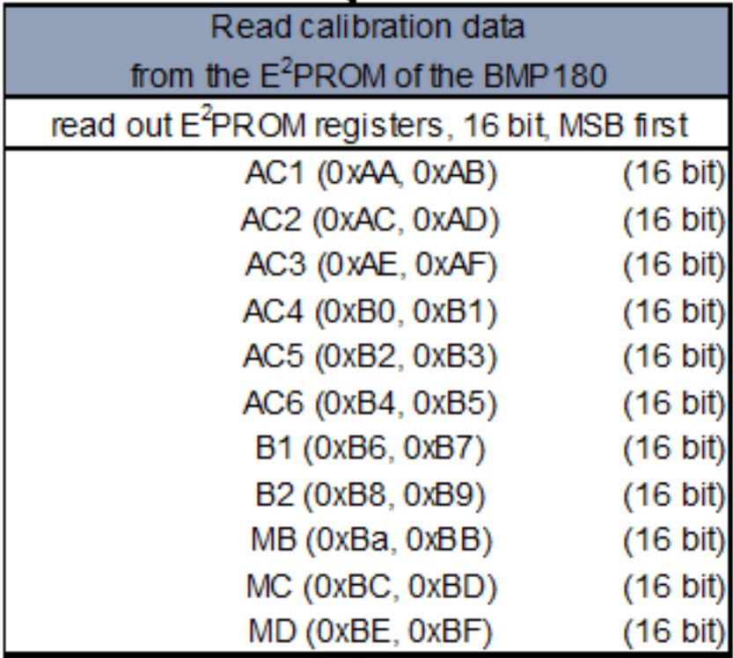
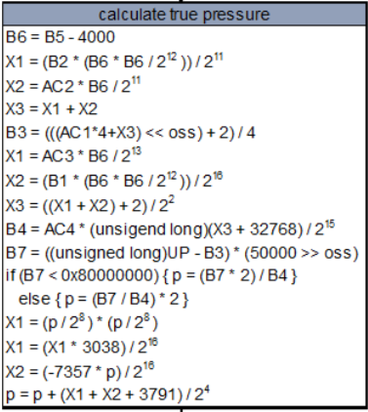
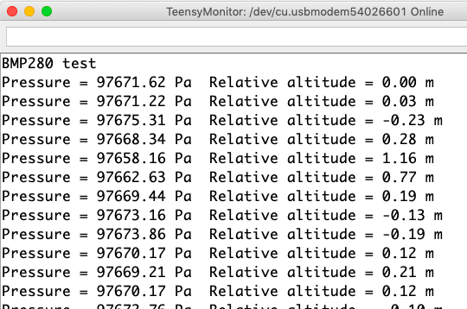
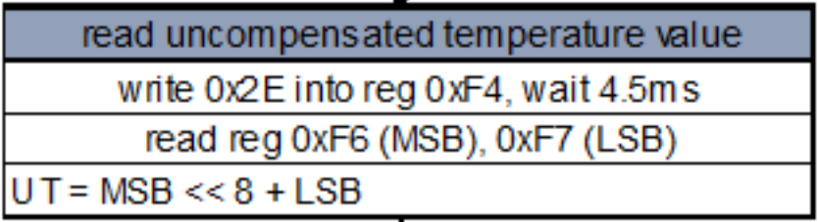
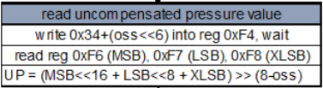
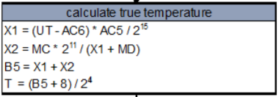
Payload Air Pressure Sensor Summary
Data Format
Algorithm for pressure and temperature measurement
Pressure will be displayed in Pascals because of the competition requirement of displaying each sensor value in engineering units with resolution of 1 pascals.
Altitude will be displayed in meters and it will be a floating point number.
Start
Source: Datasheet
Display temperature and Pressure
Presenter: Sumiran Bhasin

Slide 37
Payload Air Temperature Sensor Summary
Sensor Selected :
BMP180
Source: Datasheet
Characteristics
Low power: 5µA at 1 sample / sec. in standard mode
Low noise: 0.06hPa (0.5m) in ultra low power mode 0.02hPa (0.17m) advanced resolution mode.
Resolution of 0.1°C
Inter-face | Temperature Range (hPa) | Dimensions (mm) | Weight (g) | Working Current (mA) | Sensitivity (hPa) | Operating Voltage (V)
I2C | -40 - +85 | 14 x 12 x 0.93 | 0.92 | 1 | 土2 | 1.8 - 3.6
Data Processing
Data Format
16bit Temperature data is provided by the sensor.
I2C Interface with Teensy 3.2
Temperature will be displayed in °C because of the competition requirement of displaying each sensor value in engineering units with one tenth of a degree resolution.
Start
Display temperature
Presenter: Sumiran Bhasin
37

Slide 38
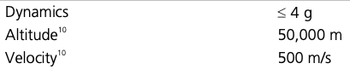
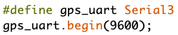
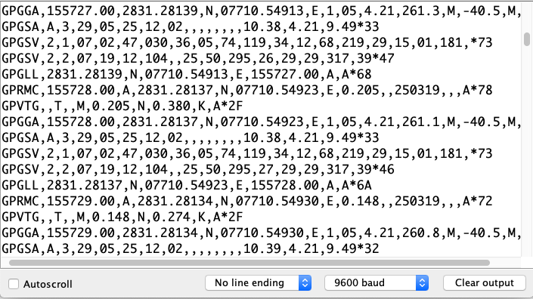
GPS Sensor Summary
Sensor Selected :
UBLOX NEO 6M
Source: Datasheet
Characteristics
The 50-channel u-blox 6 positioning engine boasts a Time-To-First-Fix (TTFF) of under 1 second. The dedicated acquisition engine, with 2 million correlators, is capable of massive parallel time/frequency space searches, enabling it to find satellites instantly.
Inter-face | Weight (g) | Horizontal accuracy(m) | Sensitivity (Tracking) | Protocols | Voltage Supply (V) | Antenna Gain (dB)
UART, USB, SPI | 12 | 2.5 | -161 dBm | NMEA, UBX, RTCM | 2.7 – 3.6 | Max. 50
Data Processing
We will be using UART Interface at baud rate set to 9600 to read NMEA sentences from UBLOX NEO 6M.
These NMEA sentences will be configured to obtain data such as Time, Altitude, Longitude, Latitude, number of satellites as per Telemetry Requirements (TinyGPS++ Library will be used that makes this process easier and efficient).
Operation Limits:
Presenter: Sumiran Bhasin

Slide 39
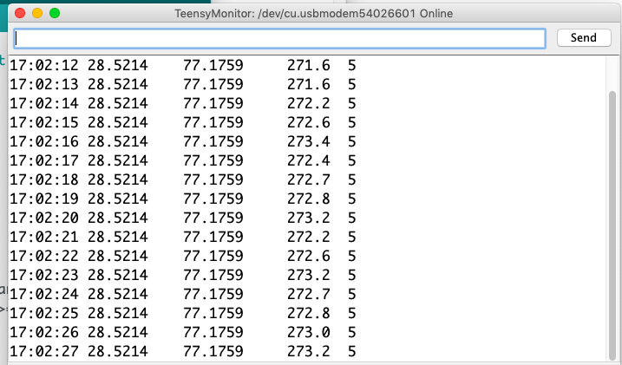
GPS Sensor Summary
Data Format
As per competition requirements data will be in following scientific units and resolution:
Time generated by the GPS receiver will be reported in UTC and will have a resolution of a second.
Latitude generated by the GPS receiver will be in decimal degrees with a resolution of 0.0001 degrees.
Longitude generated by the GPS receiver will be in decimal degrees with a resolution of 0.0001 degrees.
Altitude generated by the GPS receiver in meters above mean sea level with a resolution of 0.1 meters.
Number of GPS satellites being tracked by the GPS receiver. This must be an integer number.
Presenter: Sumiran Bhasin

Slide 40
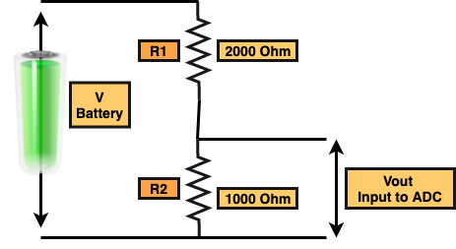
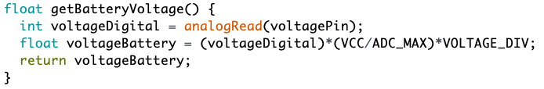
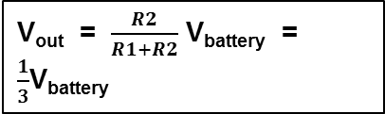
Payload Voltage Sensor Summary
Sensor Selected :
Voltage divider circuit
Characteristics
A voltage divider can be used as a crude logic level shifter to interface two circuits that use different operating voltages.
Easy to implement and flexible
Sensor | Interface | Sensiti-vity (%) | Resolution (bit) | Weight (g) | Size (mm²) | Range (V)
Voltage divider circuit | ADC port | ± 5 - ± 20 | 10 | .8 | Discrete Circuit | 0 – 9.9V
Data Processing
Data Format
ADC Pin of Teensy is connected to the output of Voltage Divider Circuit.
Accuracy is (5/210)V = 0.0049V because resolution of the ADC pin is 10bits.
This will map 9 V Battery to 3 V on the ADC of Teensy 3.2.
Voltage will be displayed with resolution of 0.01 V because of the competition requirement.
WHERE R1 = 2000 Ω
R2 = 1000 Ω
V_{out} = $\frac{R2}{R1+R2}$ V_{battery} = $\frac{1}{3}$V_{battery}
Presenter: Sumiran Bhasin

Slide 41
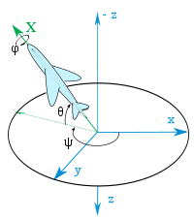
Pitch/Roll Sensor Summary
Sensor Selected :
MPU 6050
Source: Datasheet
Characteristics
The MPU-60X0 is the world’s first integrated 6-axis MotionTracking device that combines a 3-axis gyroscope, 3-axis accelerometer, and a Digital Motion Processor™ (DMP) all in a small 4x4x0.9mm package. With its dedicated I2C sensor bus, it directly accepts inputs from an external 3-axis compass to provide a complete 9-axis MotionFusion™ output.
Sensor | Model | Dimensions (mm²) | Weight (g) | Resolution (bit) | Inter-facing | Operating Current | Operating Voltage
InvenSense | GY 521 MPU 6050 | 30 x 20 | 2.1 | 16 | I2C | 3.9mA | 2.375V–3.46V
Data Processing
I2C Interface with Teensy 3.2
Gyro Range :±250 500 1000 2000°/ s
Acceleration range:±2 ±4 ±8 ±16g
Efficient and simple 6 degrees-of-freedom SENSOR FUSION ALGORITHMS are used to calculate pitch and roll of Payload.
Presenter: Sumiran Bhasin

Slide 42
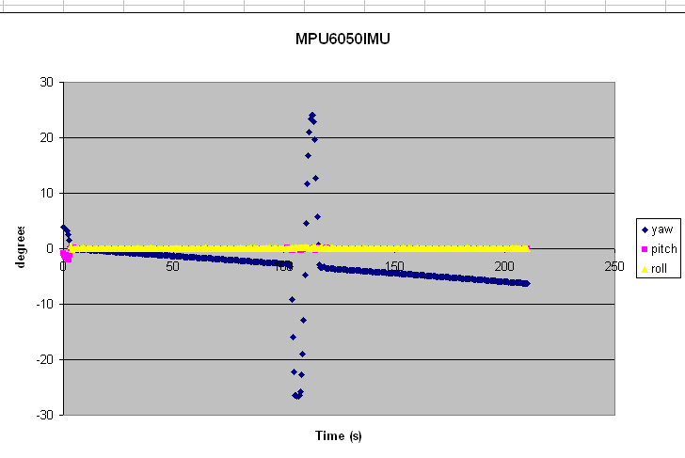
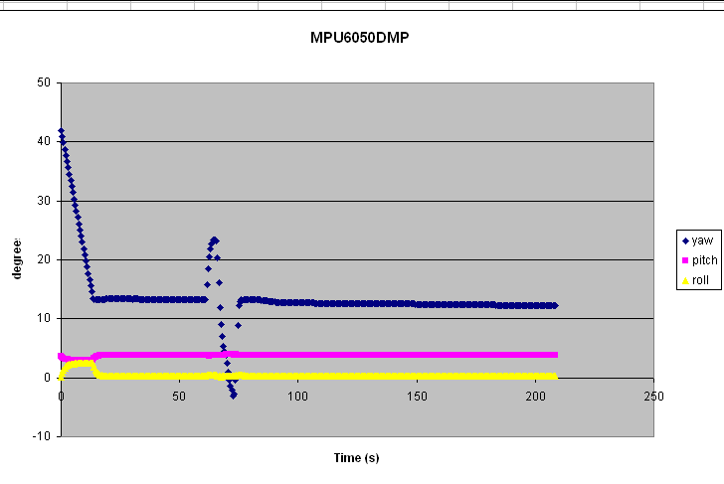
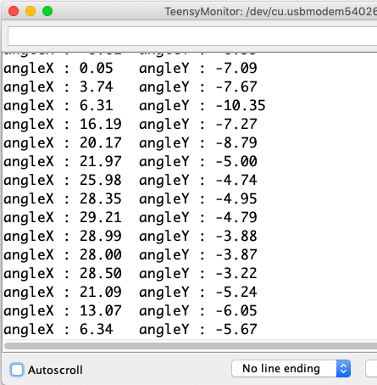
Pitch/Roll Sensor Summary
Data Format
Sensor Fusion Algorithm
According to Competition requirements:
<Pitch> is the tilt angle in the pitch axis in degrees. The resolution must be 1 degree.
<Roll> is the tilt angle of the roll axis in degrees. The resolution must be 1 degree.
MPU6050 IMU
MPU6050 DMP
We see that the filtered Roll and Pitch are essentially zero for the sensor laying flat on the table and remain so for several minutes. The Yaw is slowly changing (about 1.8 degrees per minute here) due to gyro drift. Despite the drift, the Yaw returns to trend after slight rotations at the ~two minute mark. With only one axis as a frame of reference (gravity), we can specify two reference vectors (one parallel and one perpendicular) relative to the reference direction. That leaves one direction, the Yaw, undetermined.
Again, the Roll and Pitch are unchanging since there are two good reference axes. The Yaw is drifting although at a slower rate (~0.4 degrees per minute). This also responds quickly to changes in Yaw as seen at the ~one minute mark, returning to the previous Yaw drift trajectory after the excursion. We guess that there is a sensor fusion filter, similar to what is in the sketch above, as well as low- and high-pass filters to smooth the output. We can get a sense of this by noticing the ~ten seconds it takes to get to a stable value of the Yaw, which then drifts at a slow rate.
determine the position of the gravity vector:
roll = atan2(y_Buff , z_Buff) * 57.3; pitch = atan2((- x_Buff) , sqrt(y_Buff * y_Buff + z_Buff * z_Buff)) * 57.3;
Obtain the angular position with the accelerometer by integrating the angular velocity as provided by the gyroscope: angle= angle + (gyr_angular_velocity*dt);
Start
On the short term, we use the data from the gyroscope, because it is very precise and not susceptible to external forces. On the long term, we use the data from the accelerometer, as it does not drift
angle = 0.98*(angle+gyr_data*dt) + 0.02*acc_data
Presenter: Sumiran Bhasin

Slide 43
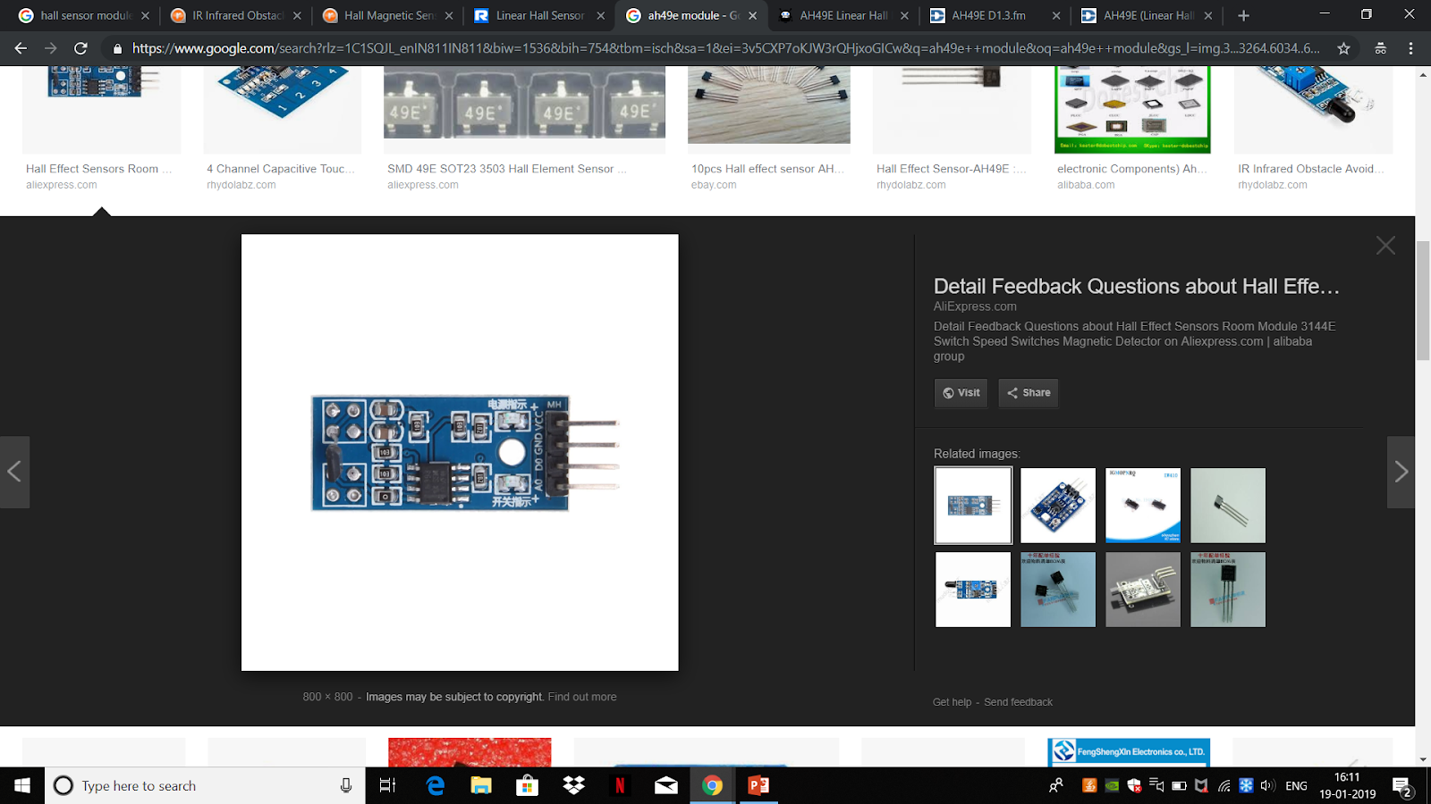
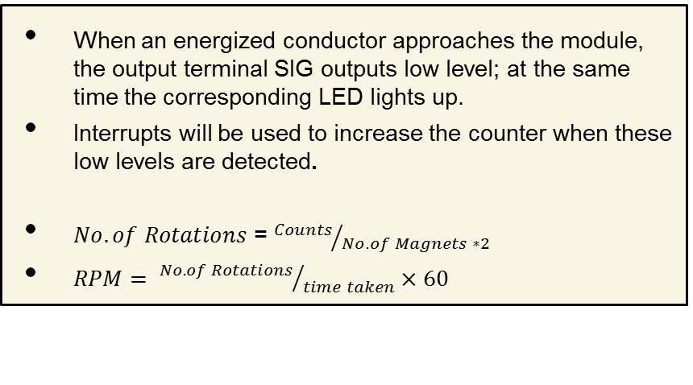
Auto-Gyro Blade Spin Rate Sensor Summary
Sensor Selected :
Hall Effect Switch
Source: Datasheet
Characteristics
A switch Hall sensor consists of voltage regulator, Hall element, differential amplifier, Schmitt trigger, and output terminal and it outputs digital values.
High precision and good linearity , Adjustable sensitivity (accurate adjustment).With no contact, abrasion, shaking, or bound.
Model | Inter-face | Concept | Dimensions (mm²) | Resolution (bit ADC or mm) | Power (mA-V) | Weight (g)
AH44E | GPIO | Hall effect module | 32 x12 | 10 bit | 3.5mA-5.0V | 3
Data Processing
Data Format
When an energized conductor approaches the module, the output terminal SIG outputs low level; at the same time the corresponding LED lights up.
Interrupts will be used to increase the counter when these low levels are detected.
$No. of Rotations$ = ${Counts}/{No. of Magnets ∗2}$
$RPM= {No. of Rotations}/{time taken}×60$
Blade spin rate is the rate the auto-gyro blades spin relative to the science payload. The units will be in revolutions per minute (rpm). The resolution will be 1 rpm as per competition requirements
Presenter: Sumiran Bhasin

Slide 44
Bonus Objective Camera Summary[1/2]
Sensor Selected :
Turbowing cyclops dvr 3
Source: Datasheet
Characteristics
Memory SD CARD CAPABLE: Cyclops 3 has a maximum capacity of 32g memory card that can usually record for 16 hours.
Remarkable ultra light model with all the bells and whistles in a single coin size module.
Provides transparent imagery, so that night traffic will not appear with excessive exposure.
Weight (g) | Power (mA V) | Resolution | Dimen-sions (mm²) | FPS | Interface | Supply Voltage (V)
4.5 | 130 x 5 | 1280 * 720 | 18 x 18 | 30 | GPIO | 5V - 26V
Data Processing
Data Format
During descent, Teensy will send command to switch on the camera when height of 450 will be detected by BMP180. This command is send via nrf24l01 to camera subsection.
Camera will be turned on by MCU by replacing the physical switch by and electronic switch.
To obtain the Bonus camera direction, teensy will ping camera subsection and will receive the camera direction in return.
The video is stored in sd card in the NTSC format
Presenter: Sumiran Bhasin

Slide 45
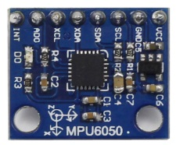
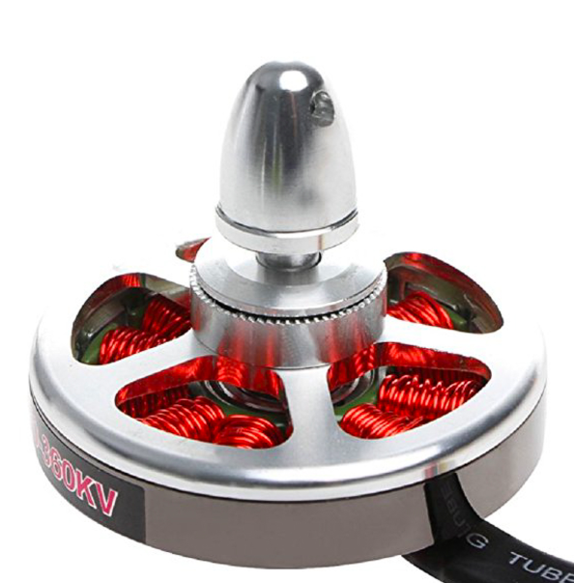
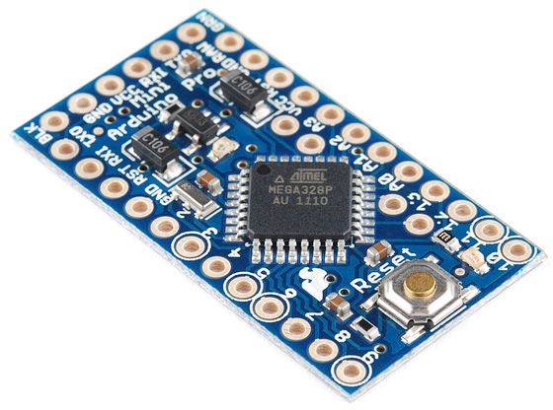
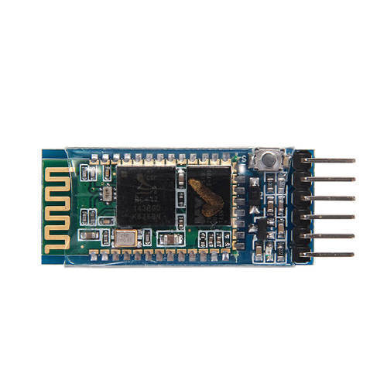
Bonus Objective Camera Summary[2/2]
Bonus Camera Subsection
This subsection has following electronics and each of them have the specific purpose:
Arduino Pro Mini: Used as MCU to perform tasks such as camera stabilization and to start video recording and data transfer/receiver from Bluetooth.
Bluetooth module: Used for two-way communication between Main telemetry System and and the bonus camera stabilization sub-system.
MPU6050: Arduino uses MPU6050 to calculate Yaw that gives feedback to stabilize the camera.
BLDC MOTOR: is rotated in in opposite direction of payload to stabilize the camera direction.
Advantages
Different Subsection for the Bonus camera will ensure that our Payload’s main telemetry section will keep functioning independently even if some problem occurs in the Bonus Task.
Servo is common choice for position control and thus it perfectly fits for direction control.
BLDC
MPU6050
Camera: Turbowing cyclops
MAIN TELEMTRY CIRCUIT
Wireless
Bluetooth module
Bluetooth module
Presenter: Sumiran Bhasin

Slide 46
Container Air Pressure Sensor Summary[1/2]
Sensor Selected :
BMP180
Source: Datasheet
Characteristics
Low power: 5µA at 1 sample / sec. in standard mode
Low noise: 0.06hPa (0.5m) in ultra low power mode 0.02hPa (0.17m) advanced resolution mode.
Resolution of 0.01hPa.
Inter-face | Pressure Range (hPa) | Dimensions (mm) | Weight (g) | Working Current (mA) | Sensitivity (hPa) | Operating Voltage (V)
I2C | 300-1100 | 14 x 12 x 0.93 | 0.92 | 1 | 土2 | 1.8 - 3.6
Data Processing
It senses Pressure and then calculates Altitude using the given formula and this value of altitude is used to determine different FSW states.
With the measured pressure p and the absolute altitude the pressure at sea level can be calculated:
where, p₀= Pressure at sea level (hPa) and p = Measured pressure (hPa)
Presenter: Sumiran Bhasin
46

Slide 47
Container Air Pressure Sensor Summary[2/2]
Data Format
Algorithm for pressure and temperature measurement
Pressure will be displayed in Pascals because of the competition requirement of displaying each sensor value in engineering units with resolution of 1 pascals.
Altitude will be displayed in meters and it will be a floating point number.
Start
Source: Datasheet
Display temperature and Pressure
Presenter: Sumiran Bhasin
47

Slide 48
Descent Control Design
Aayush Aggarwal

Slide 49
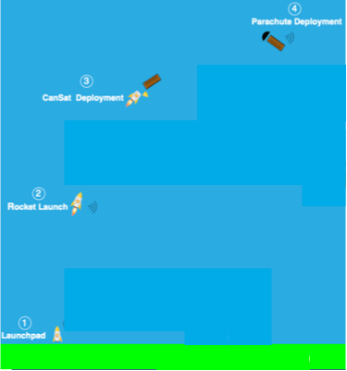
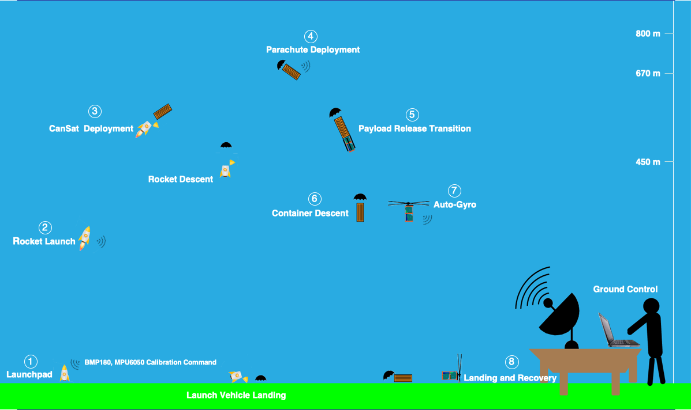
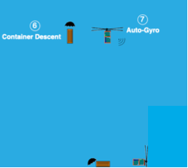
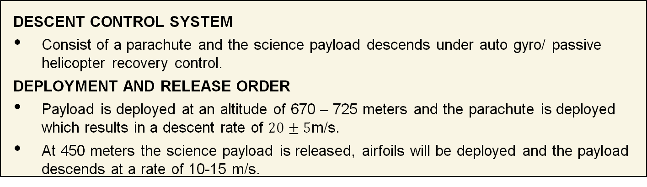
Descent Control Overview
DESCENT CONTROL SYSTEM
Consist of a parachute and the science payload descends under auto gyro/ passive helicopter recovery control.
DEPLOYMENT AND RELEASE ORDER
Payload is deployed at an altitude of 670 – 725 meters and the parachute is deployed which results in a descent rate of $20±5$m/s.
At 450 meters the science payload is released, airfoils will be deployed and the payload descends at a rate of 10-15 m/s.
DESCENT CONTROL SYSTEM
DEPLOYMENT AND RELEASE ORDER
1st Stage – Rocket Launch to Apex
2nd Stage – Apex to Payload Release till 450 m
3rd Stage – Container and Payload Descent from 450 m to ground
Presenter: Aayush Aggarwal
CanSat 2019 CDR: Team 3279(Team KALAM)

Slide 50
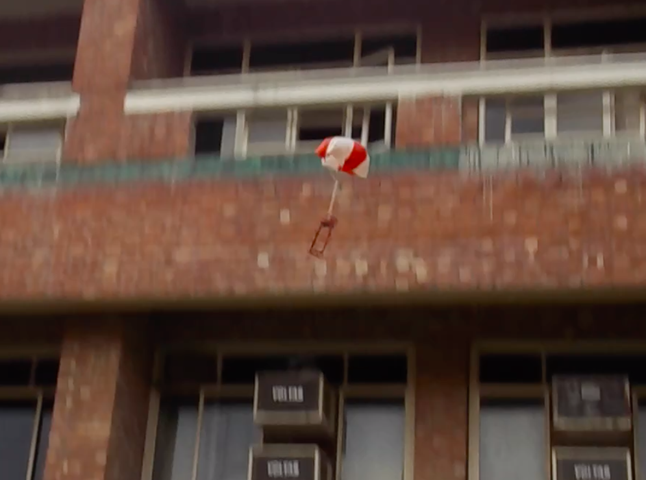
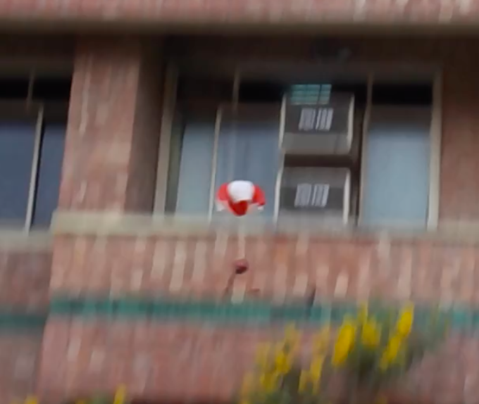
Descent Control Changes Since PDR
S. No. | Change | Requirement | Rationale
 | No change
Prototype Testing
Presenter: Aayush Aggarwal

Slide 51
Descent Control Requirements [1/3]
Number | Description | Rationale | Priority | Verification Method
 |  |  |  | A | I | T | D
DCR1 | The CanSat shall deploy from the rocket payload | Competition Requirement | HIGH | ✔️
DCR2 | The descent rate of the CanSat (container and science payload) shall be 20 meters/second +/- 5m/s. | Competition Requirement | HIGH |  |  | ✔️ | ✔️
DCR3 | The container shall release the payload at 450 meters +/- 10 meters. | Competition Requirement | HIGH |  |  | ✔️ | ✔️
DCR4 | The science payload shall descend using an auto-gyro/ passive helicopter recovery descent control system | Competition Requirement | HIGH | ✔️ | ✔️
DCR5 | The descent rate of the science payload after being released from the container shall be 10 to 15 meters/second. | Competition Requirement | HIGH |  |  | ✔️ | ✔️
Presenter: Aayush Aggarwal
CanSat 2019 CDR: Team 3279(Team KALAM)

Slide 52
Descent Control Requirements [2/3]
Number | Description | Rationale | Priority | Verification Method
 |  |  |  | A | I | T | D
DCR6 | All descent control device attachment components shall survive 30 Gs of shock. | Competition Requirements | HIGH |  | ✔️ | ✔️
DCR7 | All structures shall be built to survive 30 Gs of shock. | Competition Requirements | HIGH |  | ✔️ | ✔️
DCR8 | All mechanisms shall be capable of maintaining their configuration or states under all forces. | Competition Requirements | HIGH |  | ✔️ | ✔️
DCR9 | Mechanisms shall not use pyrotechnics or chemicals. | Competition Requirements | HIGH | ✔️ | ✔️ | ✔️ | ✔️
DCR10 | Mechanisms that use heat (e.g., nichrome wire) shall not be exposed to the outside environment to reduce potential risk of setting vegetation on fire. | Competition Requirements | HIGH | ✔️ | ✔️ | ✔️ | ✔️
Presenter: Aayush Aggarwal

Slide 53
Descent Control Requirements [3/3]
Number | Description | Rationale | Priority | Verification Method
 |  |  |  | A | I | T | D
DCR11 | The Parachute shall be fluorescent Pink or Orange. | Competition Requirements | HIGH | ✔️
DCR12 | Spring contacts shall not be used for making electrical connections to batteries. Shock forces can cause momentary disconnects. | Competition Requirements | HIGH | ✔️ | ✔️ | ✔️ | ✔️
DCR13 | The auto-gyro descent control shall not be motorized. It must passively rotate during descent. | Competition Requirements | HIGH | ✔️ | ✔️ |  | ✔️
Presenter: Aayush Aggarwal
CanSat 2019 CDR: Team 3279(Team KALAM)

Slide 54
Payload Descent Control Hardware Summary [1/3]
Active Components
Component | Sensor Accuracy | Data Format | Overview of sensor Data Processing
 |  |  | Control Action | Command Rate
BMP180 (Air Pressure and Temperature Control) | • Quite high accuracy of 0.01hPa • Temperature Coefficient of 0.01hPa per degree Celsius. • Temperature resolution of 0.1°C | I2C | Triggers the audio beacon(continuous mode) at an altitude less than 5m. | <1 Hz as the telemetry rate requirement is 1Hz.
Hall Sensor (Auto-Gyro blade spin rate sensor) | Hall effect sensor can achieve output error as low as 1% Highly accurate –detects low magnetic field | Digital Interrupt | - | <1 Hz as the telemetry rate requirement is 1Hz.
MPU6050 (Tilt Sensor) | • Fixed 10 bit resolution • High resolution is up to 13 bit | I2C | - | <1 Hz as the telemetry rate requirement is 1Hz.
GPS | Time Pulse accuracy is 30 ns. | UART | - | <1 Hz as the telemetry rate requirement is 1Hz.
Presenter: Aayush Aggarwal

Slide 55
Payload Descent Control Hardware Summary [2/3]
Passive Components
Component/concept | Component Size | Color | Key Design Considerations
Payload Body | Length = 161.51mm | Pink | Must be lightweight and made from strong material. Should include all the electronics components and descent smoothly under autogyro recovery descent control system.
Blades | Length = 207mm Width = 30mm Height = 3mm | Pink | Must be lightweight and able to open after payload release at 450 meters. Should give a descent rate of 10 - 15m/s for the payload.
Gimbal (Camera stablization) | Length = 45mm Width = 41mm Height = 32mm | _ | Takes little space, volume For Camera stabilization at an angle of 45° from nadir of the science payload
Center of Buoyancy is above center of Gravity | _ | _ | Center of buoyancy was found to be above the center of gravity due to which a self-aligning torque will nullify any forces acting to produce TUMBLING.
Presenter: Aayush Aggarwal

Slide 56
Payload Descent Control Hardware Summary [3/3]
Payload Configurations
Stowed Configuration
Transition
Deployed Configuration
Presenter: Aayush Aggarwal

Slide 57

Descent Stability Control Design [1/2]
Passive: Descent Stability Control Design
BUOYANT
FORCE
OPPOSITE MOMENT
CENTER OF BUOYANCY
CENTER OF GRAVITY
NADIR DIR
MAINTAINED
WEIGHT
FORCE
DESIGN OF METHOD
Presenter: Aayush Aggarwal
CanSat 2019 CDR: Team 3279(Team KALAM)

Slide 58
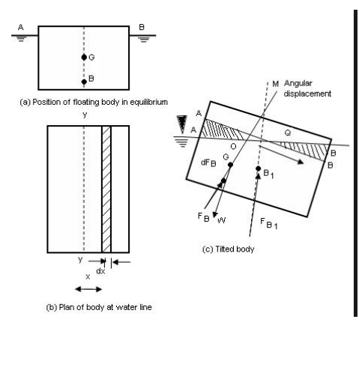
Descent Stability Control Design [2/2]
Passive: Descent Stability Control Design For Payload
Center of buoyancy was found to be above the center of gravity due to which a self-aligning torque will nullify any forces acting to produce TUMBLING.
Since both the points are very far away based on our calculations, it will form a very STABLE Equilibrium.
The inference drawn from above proves that it will always remain in the downward direction (NADIR direction).
Design of Method
KM = KB + BM
BM = I/V
Where KB is the center of buoyancy (height above the keel), I is the second moment of area of the waterplane in meters and V is the volume of displacement in meters . KM is the distance from the keel to the metacenter.
Stable floating objects have a natural rolling frequency, just like a weight on a spring, where the frequency is increased as the spring gets stiffer. In a boat, the equivalent of the spring stiffness is the distance called "GM" or "metacentric height", being the distance between two points: "G" the center of gravity of the boat and "M", which is a point called the metacenter
Presenter: Aayush Aggarwal
CanSat 2019 CDR: Team 3279(Team KALAM)

Slide 59
Container Descent Control Hardware Summary [1/3]
Active Components
Component | Sensor Accuracy | Data Format | Overview of sensor Data Processing
 |  |  | Control Action | Command Rate
BMP180 (Air Pressure and Temperature Control) | • Quite high accuracy of 0.01hPa • Temperature Coefficient of 0.01hPa per degree Celsius. • Temperature resolution of 0.1°C | I2C | Triggers the servo motor at an altitude of 450m and audio beacon(continuous mode) at an altitude less than 5m. | <1 Hz as the telemetry rate requirement is 1Hz.
Voltage Divider Circuit | Accuracy is (5/210)V = 0.0049V because resolution of the ADC pin is 10bits | ADC | - | <1 Hz as the telemetry rate requirement is 1Hz.
Presenter: Aayush Aggarwal
CanSat 2019 CDR: Team 3279(Team KALAM)

Slide 60
Container Descent Control Hardware Summary [2/3]
Passive Components
Component | Component Size | Color | Key Design Considerations
Parachute | 8 inch Diameter hexagonal chute | Red and White | Takes little packing space, volume Lightweight, sufficient drag force. Can withstand brutal openings easily. Gives us the desired descent rate of 20m/s for the CanSat and a smooth landing.
Cage | Diameter = 90mm Height = 55mm | Blue | Cage has to be designed in such a way so that there are less chances of blades getting stuck.
Presenter: Aayush Aggarwal

Slide 61
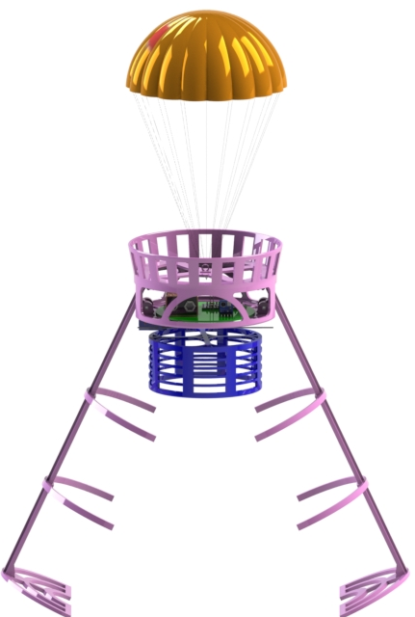
Container Descent Control Hardware Summary [3/3]
Container Configurations
Stowed Configuration
Transition
Deployed Configuration
Presenter: Aayush Aggarwal
CanSat 2019 CDR: Team 3279(Team KALAM)

Slide 62
Descent Rate Estimates [1/11]
Assumptions
Weight of the falling object is equal to drag when it travels with constant velocity (terminal velocity).
Density of air is assumed to be 1.225 kg/m
No wind or air currents.
Mass of the CanSat (container + payload) = 0.5kg
Mass of container = 0.15kg
Drag coefficient of parachute = 0.75
3
Presenter: Aayush Aggarwal
CanSat 2019 CDR: Team 3279(Team KALAM)

Slide 63
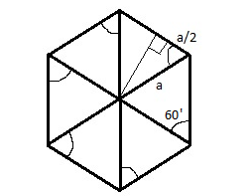
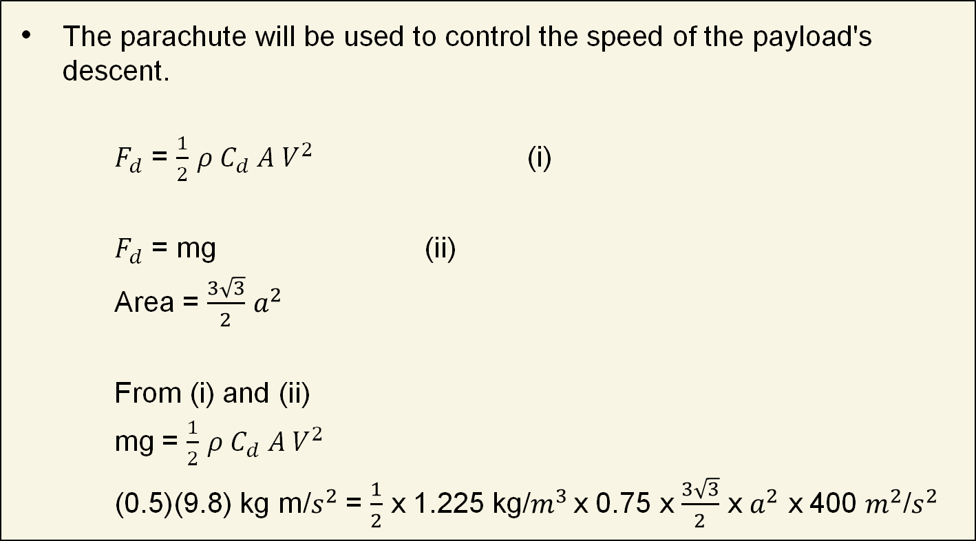
Descent Rate Estimates (Container & Payload) [2/11]
CanSat's (Container + Payload) Parachute landing Calculations
The parachute will be used to control the speed of the payload's descent.
$F_{d}$ = $\frac{1}{2}$ $ρ C_{d} A V^{2}$ (i)
$F_{d}$ = mg (ii)
Area = $\frac{3\sqrt{3}}{2}$ $a^{2}$
From (i) and (ii)
mg = $\frac{1}{2}$ $ρ C_{d} A V^{2}$
(0.5)(9.8) kg m/$s^{2}$ = $\frac{1}{2}$ x 1.225 kg/$m^{3 }$x 0.75 x $\frac{3\sqrt{3}}{2}$ x $a^{2}$ x 400 $m^{2}$/$s^{2}$
o
Hexagon made of 6 equilateral triangles
Diameter = 7.34 inches ( desired value of diameter)
Presenter: Aayush Aggarwal
CanSat 2019 CDR: Team 3279(Team KALAM)

Slide 64



Descent Rate Estimates (Container & Payload) [3/11]
mg = $\frac{1}{2}$ $ρ C_{d} A V^{2}$
CanSat (Container + Payload) Parachute Landing calculation For 8 inch Hexagonal Parachute
Area = $\frac{3\sqrt{3}}{2}$ $a^{2}$
For our parachute a = 0.11284m
v = $\sqrt{\frac{2mg}{ρC_{d}A}}$ m/s
v = $\sqrt{\frac{2(0.5)(9.8)(2)}{1.225(0.75)(3\sqrt{3} ){(0.11284)}^{2}}}$ m/s
v = $\sqrt{366.39}$m/s
v = 19.14 m/s
T = 32.12 s
Our Parachute will land with this velocity.
o
Hexagon made of 6 equilateral triangles.
Presenter: Aayush Aggarwal
CanSat 2019 CDR: Team 3279(Team KALAM)

Slide 65

Descent Rate Estimates (Container) [4/11]
Container: Container parachute landing calculation after payload is released
$F_{d}$ = $\frac{1}{2}$ $ρ$ $C_{d}$ A $V^{2}$ (i)
$F_{d}$ = mg (ii)
A = $\frac{3\sqrt{3}}{2}$ $a^{2}$
From (i) and (ii)
mg = $\frac{1}{2}$ $ρ C_{d}$ A $V^{2}$
(0.15)(9.8) kg m/$s^{2}$ = $\frac{1}{2}$ (1.225 kg/$m^{3}$)(0.75)($\frac{3\sqrt{3}}{2})$(0.11284 x 0.11284$m^{2}$)$V^{2}$
v = $\sqrt{\frac{5.88}{0.0607}}$ m/s
o
= 9.84m/s ,
T = 54.88s
Presenter: Aayush Aggarwal
Cansat 2019 CDR: Team 3279(Team KALAM)

Slide 66

Descent Rate Estimates (Container) [5/11]
Impact Energy Joules vs Weight
Presenter: Aayush Aggarwal
CanSat 2019 CDR: Team 3279(Team KALAM)

Slide 67
Descent Rate Estimates[6/11]
Parachute Specifications
Chute Style: | Hexagonal Light weight with shroud lines
Canopy Shape: | Hexagonal
Canopy Diameter(inches): | 8.00
Number Gores: | 6.00
Weight(oz): | 0.243
Weight(grams): | 6.9
Parachute Area(sq. Ft.): | 0.28
Cd Projected: | 0.75
Shroud Line Length(inches): | 8.00
Material: | 1 mil thick polyethylene plastic
Reinforcement rings: | 6.00
Manufacturer: | Apogee components
Presenter: Aayush Aggarwal
CanSat 2019 CDR: Team 3279(Team KALAM)

Slide 68


Descent Rate Estimates (Payload) [7/11]
Payload: Autogyro Blade Selection
We have selected NACA 6412 airfoil at pitch angle of 5°.
QBlade software was used to calculate the various parameters of the descent.
Airfoil geometry
Blade geometry
Presenter: Aayush Aggarwal
CanSat 2019 CDR: Team 3279(Team KALAM)

Slide 69

Descent Rate Estimates (Payload) [8/11]
Payload: Autogyro Blade Selection
The coefficient of lift and drag graphs with pitch angle are given.
Presenter: Aayush Aggarwal
CanSat 2019 CDR: Team 3279(Team KALAM)

Slide 70

Descent Rate Estimates (Payload) [9/11]
Payload: Autogyro Blade Selection
The extrapolated graphs of coefficients of lift and drag are as follows.
Presenter: Aayush Aggarwal
CanSat 2019 CDR: Team 3279(Team KALAM)

Slide 71

Descent Rate Estimates (Payload) [10/11]
Payload: Autogyro Blade Selection
The tip speed ratio was approximated to 1 and the resulting thrust at 15 m/s inflow velocity comes out to be between 3 and 3.5 N, resulting in a velocity of about 11.8 m/s and total time of flight = 45.11 s
Presenter: Aayush Aggarwal
CanSat 2019 CDR: Team 3279(Team KALAM)

Slide 72
Descent Rate Estimates [11/11]
FINAL DESCENT RATES
Parameter | Calculated Value | Flight Time (s)
Descent rate of Container + Payload | 19.14 m/s | 32.12
Descent rate of only Container | 9.84 m/s | 54.88
Descent rate of the Payload | 11.8 m/s | 45.11
Presenter: Aayush Aggarwal
CanSat 2019 CDR: Team 3279(Team KALAM)

Slide 73
Mechanical Subsystem Design
Arham Jain

Slide 74
Mechanical Subsystem Overview[1\2]
Major Structural elements
Payload​ | Container​
Payload Body​ | Parachute Section​
Rotating Hub​ | Ribs​
Propeller​ | Cage​
Gimbal​ | Parachute​
Material Selection
Payload​ | Container​
3 D printed Nylon PA-2200​ | CNC HDPE​
3 D printed HDPE​ | 3 D printed ABS​
Vacuum Formed Polycarbonate​ | Nylon Parachute​
Interface Definitions
Payload​ | Container​
Connected through cage in stowed config.​ | 2 symmetrical hinged parts connected through a torsional spring​
Springs in auto-gyro propellers for deployment​ | Motor mounted on container electronics module bottom to cut thread​
Presenter: Arham Jain

Slide 75

Mechanical Subsystem Overview[2/2]
Parachute
Spring
Servo Motor
Cage
Container Ribs
Propeller
Electronic Component
Camera stabilization
Presenter: Arham Jain

Slide 76
Mechanical Subsystem Changes Since PDR
S. No | Change | Requirement | Rationale
1 | Modified payload design | All the electronics were not getting fit inside existing design | The current design easily accommodates all the electronic components required.
Presenter: Arham Jain

Slide 77
Mechanical Sub-System Requirements
ID | Requirement | Rationale | Parent | Children | Priority | Verification Method
 |  |  |  |  |  | A | I | T | D
MSR-1 | Total mass of CanSat (science payload and container) shall be 500grams +/- 10 grams | Competition Requirement |  |  | High | ✔️ | ✔️ | ✔️
MSR-2 | CanSat shall fit in a cylindrical envelope of 125 mm diameter x 310 mm length. Tolerances are to be included to facilitate container deployment from the rocket fairing. | Competition Requirement |  |  | High | ✔️ | ✔️ | ✔️
MSR-3 | The container shall not have any sharp edges to cause it to get stuck in the rocket payload section which is made of cardboard. | Competition Requirement |  |  | High | ✔️ | ✔️
MSR-4 | Mechanisms shall not use pyrotechnics or chemicals. | Competition Requirement |  |  | High | ✔️
MSR-5 | The rocket airframe shall not be used to restrain any deployable parts of the CanSat. | Competition Requirement |  |  | High | ✔️
Presenter: Arham Jain

Slide 78
Mechanical Sub-System Requirements
ID | Requirement | Rationale | Parent | Children | Priority | Verification Method
 |  |  |  |  |  | A | I | T | D
MSR-6 | All mechanisms shall be capable of maintaining their configuration or states under all forces. | Competition Requirement |  |  | High |  | ✔️ | ✔️ | ✔️
MSR-7 | All structures shall be built to survive 15Gs of launch acceleration. | Competition Requirement |  |  | High |  | ✔️ | ✔️
MSR-8 | All structures shall be built to survive 30 Gs of shock. |  |  |  | High |  | ✔️ | ✔️
MSR-9 | Tolerances are to be included to facilitate container deployment from the rocket fairing. | Competition Requirement |  |  | High | ✔️ | ✔️
Presenter: Arham Jain

Slide 79

Payload Mechanical Layout of Components [1/6]
PAYLOAD CAD DRAWING
Presenter: Arham Jain

Slide 80


Payload Mechanical Layout of Components [2/6]
Location of Electrical Components
Electronic compartment with all the sensors on printed circuit boards
Presenter: Arham Jain

Slide 81

Payload Mechanical Layout of Components [3/6]
Autogyro Attachment Points
Hinge
Bearing
Presenter: Arham Jain

Slide 82


Payload Mechanical Layout of Components [4/6]
Major Mechanical Parts
Hinge
Gimbal
(Camera Stabilization)
Torsional spring
Presenter: Arham Jain

Slide 83

Payload Mechanical Layout of Components [5/6]
Deployed
Bearing
Stowed
Stowed
Screw + Torsional Spring
Presenter: Arham Jain

Slide 84
Payload Mechanical Layout of Components [6/6]
Component(s) | Material | Density (g/cm^3) | Tensile strength (MPa) | Cost per kg | Advantages | Disadvantages
Payload Body | HDPE - CNC (machined) | 0.97 | 32 | $30 | Strong and durable. Relatively light weight. | Stress cracking
Rotating Hub Gimbal (Camera Stabilizer) | NYLON PA 2200 - 3D PRINTING (FDM) | 0.93 | 48 | $25-65 | Flexible and strong UV and chemical resistant | Constantly meant to keep dry It can shrink
Payload Propeller | POLYCARBONATE - 3D PRINTING (MJ) | 1.2 | 72 | $40-75 | Flexible and Durable High Tensile Strength | Needs Warm environment for optimum quality High price
Presenter: Arham Jain

Slide 85

Container Mechanical Layout of Components [1/5]
CONTAINER CAD DRAWING
Presenter: Arham Jain

Slide 86


Container Mechanical Layout of Components [2/5]
Parachute
Servo Motor
Cage
Ribs
Base
Presenter: Arham Jain

Slide 87


Container Mechanical Layout of Components [3/5]
Presenter: Arham Jain

Slide 88



Container Mechanical Layout of Components [4/5]
Spring for container opening
Hinge for container ribs opening
3D printed parachute compartment
Presenter: Arham Jain

Slide 89
Container Mechanical Layout of Components [5/5]
Component(s) | Material | Density (g/cm^3) | Tensile strength (MPa) | Cost per kg | Advantages | Disadvantages
Parachute Mounting Lid Container Cage | ABS - 3D PRINTING (FDM) | 1.06-1.08 | 27-46 | $10-40 | Mechanically strong and long life span | Toxic and required heated bed
Container Rib (Body) Container Ribs Container Base Container Parachute Section | HDPE - CNC (machined) | 0.97 | 32 | $30 | Strong and durable. Relatively light weight. | Stress cracking
Presenter: Arham Jain

Slide 90

Payload Release Mechanism [1/2]
Thread
Thread
The payload rests on the container base and the cage stops the blades from opening, while the CanSat descents.
As a result of the thread cutting, the spring pulls the ribs of the container open. The payload starts to slip down the container.
The servo motor cuts the Kevlar thread as the altitude reaches 450m.
Presenter: Arham Jain

Slide 91
Payload Release Mechanism [2/2]
The payload gets free from the cage and container. The autogyro blades start opening.
The autogyro blades open fully and the payload descents with 20m/s velocity.
Presenter: Arham Jain

Slide 92


Container Parachute Release Mechanism
Attachment
Point
Parachute is folded and placed in a compartment having diameter of 110mm and height 24mm. The compartment is open from above.
The attachment threads of the parachute are tied to the hook at the middle of the container. The parachute opens due to air pressure as soon as the CanSat is deployed from the rocket.
Presenter: Arham Jain

Slide 93





Structure Survivability
Silicon glue will be used for final mounting of all the components
to ensure that nothing falls loose
PCB is screwed to the mainframe using Philips screws
Servo motor used for parachute opening will be clamped on the curved surface.
Hot glue is used to clamp jumpers to the wall for BMP180.
Presenter: Arham Jain

Slide 94
Mass Budget [1/8]
ELECTRONICS – PAYLOAD (1/2)
Part |  | Component Name | Quantity | Mass (g) | Ext. Mass (g) | Uncertainty (Tolerance) | Uncertainty (g) | Sources | Method of Correction
Microcontroller |  | Teensy 3.2 | 1 | 5.2 | 5.2 | 0.1 | 0.005 | Actual | -
Sensors | Air Pressure | BMP180 | 1 | 0.9 | 0.9 | 0.1 | 0.0009 | Actual | -
 | Temperature
Tilt Sensor |  | MPU-6050 | 1 | 2.1 | 2.1 | 0.1 | 0.002 | Actual | -
Autogyro Blade spin Sensor |  | AH44E | 1 | 2.9 | 2.9 | 0.1 | 0.003 | Actual | -
GPS Sensor |  | GPS NEO 6M | 1 | 12 | 5.4 | 0.01 | 0.0005 | Datasheet | -
Power Voltage Sensor |  | Voltage Divider Circuit | 1 | 0.8 | 0.8 | 0.1 | 0.0008 | Actual | -
XBEE Radio |  | XBEE Pro S2C | 1 | 4.3 | 4.3 | 0.1 | 0.004 | Actual | -
CanSat Antenna |  | FXP70 Freedom (Patch Antenna) | 1 | 1.2 | 1.2 | 0.1 | 0.001 | Actual | -
Audio Beacon |  | MCKPI-G2437 | 1 | 1.86 | 1.9 | 0.01 | 0.0002 | Datasheet | -
Battery |  | 9V Li-Ion | 2 | 33.00 | 66.0 | 0.01 | 0.003 | Datasheet | -
BLDC Motor |  | 82212/13T | 1 | 40.7 | 40.7 | 0.1 | 0.051 | Actual | -
Camera Stabilization |  | TurboWing Cyclops DV | 1 | 4.5 | 4.5 | 0.1 | 0.004 | Datasheet | M1
 |  | ESC | 1 | 15.0 | 15.0 | 0.1 | 0.015 | Actual | Metallic portion on the wires will be stripped off
Presenter: Arham Jain

Slide 95
Mass Budget [2/8]
ELECTRONICS – PAYLOAD (2/2)
Part | Component Name | Quantity | Mass (g) | Ext. Mass (g) | Uncertainty (Tolerance) | Uncertainty (g) | Sources | Method of Correction
SD Card Module | Generic SD Card Module | 1 | 5.79 | 5.8 | 0.01 | 0.0005 | Datasheet | -
SD Card | SanDisk Class 10 | 1 | 0.5 | 0.5 | 0.1 | 0.0005 | Actual | -
RTC | DS 3231 | 1 | 7.8 | 7.8 | 0.1 | 0.007 | Actual | -
Voltage Regulator | LM 7805(5V) | 1 | 1.84 | 1.8 | 0.01 | 0.0001 | Datasheet | -
Voltage Regulator | LM1117(3.3V) | 1 | 0.98 | 1.0 | 0.01 | 0.0001 | Datasheet | -
PCB | - | 2 | 14 | 28.0 | - | - | Estimated | M2
External Switch | SPDT Switch | 1 | 1 | 1.0 | - | - | Estimated | M3
Misc. | Jumpers, LEDs | - | 10 | 10.0 | - | - | Estimated | M4
METHODS OF CORRECTION
M1(Camera) | The complete casing of the ca
M2 (PCB) | Making circular pcb
M3(External Switches) | Using SPST switches instead of SPDT
M4(Misc.) | Using mini-jumper wires/ single-core wires instead of normal Jumpers wires
Presenter: Arham Jain

Slide 96
Mass Budget [3/8]
ELECTRONICS – CONTAINER
Part | Component Name | Quantity | Mass (g) | Ext. Mass (g) | Uncertainty (Tolerance) | Uncertainty (g) | Sources | Method of Correction
Servo Motor | Micro Servo (9g) | 1 | 11.7 | 11.7 | 0.1 | 0.01 | Actual
Air Pressure Sensor | BMP180 | 1 | 0.9 | 0.9 | 0.1 | 0.0009 | Actual | -
Voltage Regulator | LM1117(3.3V) | 1 | 0.98 | 1.0 | 0.01 | 0.0001 | Datasheet | -
Voltage Regulator | LM 7805(5V) | 1 | 1.84 | 1.8 | 0.01 | 0.0001 | Datasheet | -
Audio Beacon | MCKPI-G2437 | 1 | 1.86 | 1.9 | 0.01 | 0.0001 | Datasheet | -
Battery | 9V Li-Ion | 1 | 40.00 | 40.0 | 0.01 | 0.004 | Datasheet
Microcontroller | Arduino Pro Mini | 1 | 4.00 | 4.0 | 0.01 | 0.0004 | Datasheet
External Switch | SPDT Switch | 1 | 1 | 1.0 | - | - | Estimated | M2
PCB |  | 1 | 7 | 7.0 | - | - | Estimated | M1
Misc. | Jumpers, LEDs | - | 6 | 6.0 | - | - | Estimated | M3
METHODS OF CORRECTION
M1 (PCB) | Making circular pcb
M2(External Switches) | Using SPST switches instead of SPDT
M3(Misc.) | Using mini-jumper wires/ single-core wires instead of normal Jumpers wires
Presenter: Arham Jain

Slide 97
Mass Budget [4/8]
TOTAL ELECTRONICS MASS BUDGET
Electronics Payload Total Mass | 204.8 ± 1.26g
Electronics Container Total Mass | 75.28 ± 0.25g
TOTAL | 280.08 ± 1.51g
Presenter: Arham Jain

Slide 98
Mass Budget [5/8]
MECHANICAL – PAYLOAD
 | Part | Material | Quantity | Mass (g) | Ext. Mass (g) | Uncertainty (Tolerance) | Uncertainty (g) | Sources | Method of Correction
Structural Elements | Payload Body​ | 3D printed HDPE​ | 1 | 18.26 | 18.3 | 0.1 | 0.03 | Actual | -
 | Rotating Hub | 3D printed nylon PA-2200​ | 1 | 11.02 | 11.0 | 0.01 | 0.001 | Actual | M5
 | Propeller | Vacuum formed polycarbonate​ | 4 | 16.37 | 45.5 | 0.01 | 0.002 | Simulated | -
 | Gimbal (Camera Stabilization) | 3D printed nylon PA-2200​ | 1 | 16.0 | 16.0 | - | - | Estimated | -
Misc.Components | Misc. | Adhesives, nuts, bolts, screws etc. | - | 8 | 8.0 | - | - | Estimated | M6
 | TOTAL |  |  | 108.65 | 98.78 | 0.12 | 0.033
METHODS OF CORRECTION
M5 | Replacing the nylon PA-2200 material with the HDPE material as HDPE is lighter than nylon PA-2200.Although we’ll have to compromise on some properties, but HDPE will survive the high impact strength.
M6 | Ensuring that Adhesives are used in limited quantity.
Presenter: Arham Jain

Slide 99
Mass Budget [6/8]
MECHANICAL – CONTAINER
 | Part |  | Material | Quantity | Mass (g) | Ext. Mass (g) | Uncertainty (Tolerance) | Uncertainty (g) | Sources | Method of Correction
Structural Elements | Parachute Section |  | CNC machined HDPE | 1 | 22.26 | 22.26 | 0.01 | 0.004 | Simulation
 | Ribs | Main Body | CNC machined HDPE | 2 | 11.82 | 23.64 | 0.01 | 0.003 | Simulation
 |  | Supporting Body | CNC machined HDPE | 4 | 9.52 | 38.1 | 0.01 | 0.001 | Simulation
 |  | Base | CNC machined HDPE | 2 | 9.54 | 18.1 | 0.01 | 0.001 | Simulation
 | Cage |  | 3D printed ABS | 1 | 11.2 | 11.2 | 0.1 | 0.01 | Actual
Components | Parachute |  | TFR Thin Mill Chutes | 1 | 12.8 | 12.8 | 0.1 | 0.01 | Datasheet
Misc. Components | Misc. |  | Adhesives, nuts, bolts, Kevlar thread, screws, torsional spring etc. |  | 8 | 8.0 |  |  | Estimated | M6(Ensuring that Adhesives are used in limited quantity)
TOTAL |  |  |  |  | 99.24 | 130.14 | 0.24 | 0.029
Presenter: Arham Jain

Slide 100
Mass Budget [7/8]
TOTAL MASS BUDGET
PAYLOAD
CONTAINER
TOTAL MASS OF STRUCTURAL ELEMENTS | 201.09 ± 0.26g
TOTAL MASS OF OTHER COMPONENTS | 307.11 ± 1.61g
Presenter: Arham Jain

Slide 101
Mass Budget [8/8]
TOTAL MASS BUDGET
TOTAL MASS OF THE CANSAT | 508.86 ± 1.87g
MARGIN
510.73g – 500g = 10.73g | 10.73g
506.99g – 500g= 6.99g | 6.99 g
METHODS OF CORRECTION
In case total mass of the CanSat measured at the launch site is different than expected, the following methods of correction will be followed:
MASS < 490g | MASS > 510g
The container made of Nylon PA-2200 will be used. | The container made of HDPE will be used.
Presenter: Arham Jain

Slide 102
Communication and Data Handling (CDH) Subsystem Design
Ishita Kochar

Slide 103


CDH Overview
Payload CDH Overview
Container CDH Overview
Presenter: Ishita Kochar

Slide 104
CDH Requirements[1/3]
ID | Requirement | Rationale | Parent | Priority | Verification Method
 |  |  |  |  | A | I | T | D
PCDH-01 | Mission time shall be transmitted through telemetry with resolution of 1 sec or better. It shall not change even if the processor resets during the launch. | Competition Requirement | BR- 30 | Very High | ✔️ |  | ✔️
PCDH-02 | The CanSat payload shall transmit telemetry. It shall include the data of all the sensors and it would be collected at 1Hz sample rate. | Telemetry Requirement |  | Very High | ✔️ |  | ✔️
PCDH-03 | Telemetry shall be accomplished using XBee radios. 2.4GHz radios are used. 900MHz radios are also allowed. | Competition Requirement | BR- 31 | Very High | ✔️ |  | ✔️
PCDH-04 | XBees shall operate in unicast mode only. | Competition Requirement | BR- 33 | Very High | ✔️ | ✔️ | ✔️
Presenter: Ishita Kochar

Slide 105
CDH Requirements[2/3]
ID | Requirement | Rationale | Parent | Priority | Verification Method
 |  |  |  |  | A | I | T | D
PCDH-05 | The NETID/PANID of XBee radios should be same as the team number. | Competition Requirement | BR- 32 | High | ✔️ | ✔️ | ✔️
PCDH-06 | Telemetry data of all sensors shall be displayed in real time in a csv file. | Competition Requirement | BR- 29 | Very High | ✔️ | ✔️ | ✔️ | ✔️
PCDH 07 | The telemetry shall be displayed in engineering units (meters, meters/sec, Celsius, etc.) | Competition Requirement | BR- 37 | High |  | ✔️ | ✔️
PCDH-08 | Telemetry data shall also be plotted wrt time. | Competition Requirement | BR- 38 | Very High | ✔️ |  | ✔️
PCDH-09 | Once the payload lands, all telemetry shall stop and an audio beacon shall activate. | Competition Requirement | BR- 47 | Very High |  | ✔️ | ✔️ | ✔️
Presenter: Ishita Kochar

Slide 106
CDH Requirements[3/3]
ID | Requirement | Rationale | Parent | Priority | Verification Method
 |  |  |  |  | A | I | T | D
CCDH-1 | Container shall comprise of pressure sensor to calculate height, battery, microcontroller and servo motor. | By calculating altitude, the servo would be commanded to move at 450m. |  | Very high | ✔️ | ✔️ | ✔️
CCDH-2 | Container electronics is responsible for the payload separation mechanism at 450m. | Competition requirement | BR9 | Very high |  | ✔️
CCDH-3 | The payload shall be separated from container by cutting a cotton thread from a servo once the altitude becomes 450m. | Safe and reliable mechanism, effective when a sharp blade is attached on it to cut the thread. | BR9 | Very high | ✔️ |  | ✔️
CCDH-4 | The software state shall change when altitude of CanSat is 450m. | To indicate that the container has opened at 450m altitude. | BR9 | Very high |  | ✔️
Presenter: Ishita Kochar

Slide 107


Payload Processor & Memory Selection
Source: Datasheet
SELECTED MCU :
Teensy 3.2
Input Voltage (V) | 3.3-12
Processor and | MK20DX256VLH7 Cortex-M4
CPU Speed (MHz) | 72
Boot Time (seconds) | 1
Flash Memory (kB) | 256
SRAM (kB) | 64
EEPROM (kB) | 3
Weight (g) | 5
CAN Bus | 1
Characteristics
Up to 50 MHz ARM Cortex-M4 core with DSP instructions delivering 1.25 Dhrystone MIPS per MHz
Large number of communication interfaces.
Multiple low-power modes to provide power optimization based on application requirement.
Intefaces:
Digital I/O – 34 Analog Input – 22 Analog Output – 1
UART – 3 SPI – 1 I2C – 2
Presenter: Ishita Kochar

Slide 108

Payload Processor & Memory Selection
SELECTED:
Arduino SD Card Module
Source: Datasheet
Characteristics
The module (MicroSD Card Adapter) is a Micro SD card reader module for reading and writing through the file system and the SPI interface driver, SCM system can be completed within a file MicroSD card
Support Micro SD Card, Micro SDHC card (high speed card)
Level conversion circuit board that can interface level is 5V or 3.3V
Power supply is 4.5V ~ 5.5V, 3.3V voltage regulator circuit board
Communications interface is a standard SPI interface.
Level conversion circuit: Micro SD card to signal the direction of converts 3.3V, MicroSD card interface to control the direction of the MISO signal is also converted to 3.3V, general AVR microcontroller systems can read the signal;
Micro SD card connector: self bomb deck, easy card insertion.
Model | Weight (g) | Interface | Memory Space (GB) | Price ($)
Arduino SD Card Module | 6 | SPI | 16 (expandable) | 1.81
Presenter: Ishita Kochar

Slide 109

Payload Processor & Memory Selection
SELECTED:
SanDisk 16 GB
Source: Datasheet
Characteristics
Password protection
Built-in write protection features (permanent and temporary)
Supports card detection (insertion and removal)
Application-specific commands
Up to 25 MB/sec data transfer rate (using four parallel data lines)
Variable clock rate 0-25 MHz (standard), 0-50 MHz (high performance)
Model | Features | Memory Space (GB) | Cost
SanDisk 16 GB | 25 MB/sec data transfer rate SD - protocol compatible Supports SPI Mode Read speed : 96 MB/s | 16 | $3.5
Presenter: Ishita Kochar

Slide 110

Payload Real-Time Clock
SELECTED RTC:
Hardware RTC DS3231
Source: Datasheet
Characteristics
Low Power Operation Extends Battery-Backup Run Time.
Fast (400kHz) I2C Interface.
Highly Accurate RTC Completely Manages All Timekeeping Functions • Real-Time Clock Counts Seconds, Minutes, Hours, Date of the Month, Month, Day of the Week, and Year, with Leap-Year Compensation Valid Up to 2100 • Accuracy ±2ppm from 0°C to +40°C • Accuracy ±3.5ppm from -40°C to +85°C • Digital Temp Sensor Output: ±3°C Accuracy • Register for Aging Trim • Two Time-of-Day Alarms • Programmable Square-Wave Output Signal
MODEL | HARDWARE/ SOFTWARE | WEIGHT/ SIZE | RESET TOLERANCE | COST | V-SUPPLY | ACCURACY | INTER-FACE
DS3231 | HARDWARE | 8g | After reset condition external clock still keeps the mission time | $ 1.4 | 2.3 to 5.5 V (Coin Cell Battery) | ±2 ppm from 0°C to +40°C | I2C
Presenter: Ishita Kochar

Slide 111

Payload Antenna Selection
SELECTED Antenna:
FXP70 Freedom
Source: Datasheet
Characteristics
The FXP70 Freedom 2.4GHz Antenna works on WiFi, ZigBee, Bluetooth and ISM band at 2.4GHz.
Efficiency : 80%
Free Space Peak Gain: 1.5dBi
Impedance: 50 Ohms
Polarization: Linear
Model | Peak Gain | Dimensions | Directivity | Weight | Connector | Range (Frequency range) | VSWR | Range
FXP70 Freedom | 5dBi | 27mm*25mm* 0.08 mm | Omni | 1.2g | MHFI (U.FL Compatible) | 2.4GHz | <1.5-1 | 2 km
Presenter: Ishita Kochar

Slide 112





Payload Antenna Selection
Radiation Pattern of FXP70 Freedom
Source: Datasheet
Radiation pattern XZ Plane
Radiation pattern YZ Plane
Radiation pattern XY Plane
GAIN of FXP70 Freedom Patch Antenna
S11(Return Loss) of FXP70 Patch Antenna
Presenter: Ishita Kochar

Slide 113

Payload Radio Configuration
SELECTED Radio:
XBEE PRO S2C
Source: Datasheet
Characteristics
Low Operating Current and Range is within our Requirements with very good Margins.
XBee Radio Module is interfaced to the Teensy3.2 through USART Communication Protocol.
PAN ID will be set to Team Number 3279.
The XBEE Radio is configured using AT Mode (Ground Station being Coordinator AT & payload Xbee as Router AT).
Successful testing upto receiving packets at range of 1km with parabolic antenna
Line of Sight Range | Transmit Power output | Receiver Sensitivity (dBm) | Supply Voltage (V) | Weight (g) | Operating Frequency | Power down Current
Up to 2 miles. | 63mW (+18dBm) | -101 | 2.1-3.6 | 4.3 | ISM 2.4GHz | <1μA
Transmission Control: Transmission begins as and when CanSat is powered and sends data to ground station during each mission phase. Telemetry stops when payload is below 5m during decent state
Presenter: Ishita Kochar

Slide 114

Payload Radio Configuration
Presenter: Ishita Kochar

Slide 115

Payload Telemetry Format
The Telemetry consists of :
All the Sensory data must be in Engineering Units(meters, meters/sec, Celsius, etc.)
Data transmitted at default Baud Rate of 9600 in ‘Continuous Mode’.
Data is transmitted in ASCII Format with values separated by a comma( , ) .
Example telemetry given above is provided with system prototype.
Example telemetry matches with competition guide requirements.
Telemetry is saved on the ground station computer as CanSat_TEAM_KALAM.csv .
Telemetry Format :
<TEAM ID>,<MISSION TIME>,<PACKET COUNT>,<ALTITUDE>, <PRESSURE>, <TEMP>,<VOLTAGE>,<GPS TIME>,<GPS LATITUDE>,<GPS LONGITUDE>,<GPS ALTITUDE>,<GPS SATS>,<PITCH>,<ROLL>,<BLADE SPIN RATE>,<SOFTWARE STATE>,<BONUS DIRECTION>
3279,5,5, 0.2, 101465, 24.3,8.96, 17:47:36.0, 53.2734, 77.0389,7, 273,0,36,2,1.2
The Telemetry consists of :
Telemetry Format and Data Included :
Example :
Presenter: Ishita Kochar

Slide 116

Container Processor & Memory Selection
SELECTED MCU
Arduino Pro Mini
Source: Datasheet
Characteristics
The Arduino Pro Mini is an ATmega168 based microcontroller board.
High performance, low power AVR® 8-bit microcontroller
Advanced RISC architecture . 131 powerful instructions – most single clock cycle execution
Two 8-bit Timer/Counters with separate prescaler and compare mode
Low power consumption Active mode: 4MHz, 3.0V: 1.8mA Power-down mode: 5µA at 3.0V
Intefaces:
Digital I/O – 14 Analog Input – 6 Hardware UART-1 SPI – 1 I2C – 1
Input Voltage (V) | 3.3-12
Processor and | ATmega168
CPU Speed (MHz) | 8
Boot Time (seconds) | 8
Flash Memory (kB) | 32
SRAM (kB) | 2
EEPROM (kB) | 1
Weight (g) | 4
Data Bus | 8 bit
Presenter: Ishita Kochar

Slide 117
Electrical Power Subsystem Design
Anmol Gulati

Slide 118
EPS Overview
Payload EPS
Container EPS
Component Type | Model | Description
Battery(A) | EBL 9V Li-ion battery | Main power source
Battery(B) | EBL 9V Li-ion battery | Powers Camera Sub-System
Voltage Divider | --- | Measuring Battery Voltage
3.3V Regulator | LM1117V Regulator | Regulates voltage for 3.3V specific sensors.
5V Regulator | L7805CV Regulator | Regulates voltage for 5V specific sensors.
Tertiary battery | CR2032 | Power for RTC
Switch | SPDT Switch | Controls power on/off
DC-DC Voltage Convertor | MT3608 | 9V – 12V booster for buzzer
Component Type | Model | Description
Battery | EBL 9V Li-ion battery | Main power source
3.3V Regulator | LM1117V Regulator | Regulates voltage for 3.3V specific sensors and MCU.
Switch | SPDT Switch | Controls power on/off
DC-DC Voltage Convertor | MT3608 | 9V – 12V booster for buzzer
Presenter: Anmol Gulati

Slide 119

EPS Overview
Presenter: Anmol Gulati

Slide 120
EPS Changes Since PDR
PAYLOAD
What | In PDR | In CDR | Rationale
12V booster for buzzer | -- | MT3608 | 1. Buzzer gives desired output only when operated at maximum rated voltage
CONTAINER
What | In PDR | In CDR | Rationale
Container battery | APT-HW9V10 | EBL Li-ion | 1. Higher battery capacity 2. Lesser weight 3. Performs equally well in low and as well as high rate of discharge.
12V booster for buzzer | -- | MT3608 | 1. Buzzer gives desired output only when operated at maximum rated voltage
Presenter: Anmol Gulati

Slide 121
EPS Requirements
ID | Requirement | Rationale | Parent | Priority | Verification Method
 |  |  |  |  | A | I | T | D
EPS-1 | The payload must include an easily accessible power switch. | Competition Requirement | BR- 45 | Very high |  | ✔️
EPS-2 | The payload must include a power indicator such as an LED that can be easily seen without disassembling the CanSat. | Competition Requirement | BR- 46 | Very high |  | ✔️ | ✔️
EPS-3 | Battery source may be alkaline, Ni-Cad, Ni-MH, Lithium or Lithium-ion. Lithium polymer batteries are not allowed. | Competition Requirement | BR- 49 | Very high | ✔️ | ✔️
EPS-4 | An audio beacon is required for the payload. It may be powered after landing or operate continuously and the sound level should be minimum 92dB unobstructed. | Competition Requirement | BR- 47 | Very high |  |  | ✔️ | ✔️
Presenter: Anmol Gulati

Slide 122
EPS Requirements
ID | Requirement | Rationale | Parent | Priority | Verification Method
 |  |  |  |  | A | I | T | D
EPS-5 | All electronic components shall be shielded from the environment except sensors. | Competition Requirement | BR- 13 | Very high |  | ✔️
EPS-6 | Payload/Container shall operate for a minimum of two hours when integrated into rocket. | Competition Requirement | BR- 55 | High | ✔️
EPS-7 | Spring contacts shall not be used for making electrical connections to batteries. Shock forces can cause momentary disconnects. | Base Requirement | BR- 51 | High | ✔️ | ✔️
Presenter: Anmol Gulati

Slide 123

Payload Electrical Block Diagram
12V
Boost 9-12V
12V
Presenter: Anmol Gulati

Slide 124


Payload Power Source
Model | Weight | Type | Voltage | Capacity | Cost
EBL Li-ion battery | 37g | Li-ion | 9V | 600mAh | $10.18
The rated Voltage of the battery is 9V and the Current capacity is 600mAh. The experimental values show that the battery can provide a current of 580mA for one hour before being dead.
Presenter: Anmol Gulati

Slide 125
Payload Power Budget
S.No | Component | Voltage (V) | Current(mA) | Error (mA) | Power(W) | Operation time | Wh Requirements | Duty Cycle | Source/ Uncertainty
1. | BMP 180 | 3.3 | 0.65 | 0.5 | 0.002145 | 2 hours | 0.00429 | 100% | Datasheet
2. | TEENSY 3.2 | 3.3 | 45 | 0.5 | 0.1485 | 2 hours | 0.297 | 100% | Datasheet
3. | UBLOX NEO 6M | 3.3 | 10 | 1.0 | 0.033 | 2 hours | 0.066 | 100% | Datasheet
4. | RTC-DS3231 | 3.3 | 0.08 | 0.5 | 0.00026 | 2 hours | 0.00052 | 100% | Datasheet
5. | LM1117 | 5 | 10 | 0.0 | 0.05 | 2 hours | 0.066 | 100% | Datasheet
6. | MPU 6050 | 3.3 | 1.74 | 0.5 | 0.0057 | 2 hours | 0.01148 | 100% | Datasheet
7. | AUTO GYRO SPIN RATE SENSOR AH49E | 3.3 | 3.5 | 0.0 | 0.0115 | 2 hours | 0.0231 | 100% | Datasheet
8. | MICRO-SD CARD MODULE | 3.3 | 25 | 0.5 | 0.0825 | 2 hours | 0.165 | 100% | Datasheet
9 | BUZZER(MCKPI-G2437-3671) | 5 | 8.3 | 0.5 | 0.041 | 1 hour | 0.041 | 50% | Estimated
10. | MT3608 | 9 | 1.8 | 0.4 | 0.016 | 1 hour | 0.016 | 50% | Estimated
11 | XBEE PRO S2C | 3.3 | 60 | 0.5 | 0.198 | 2 hours | 0.396 | 100% | Datasheet
12 | LM7508 | 9 | 10 | 0.0 | 0.09 | 2 hours | 0.18 | 100% | Datasheet
13 | CAMERA | 5 | 130 | 0.5 | 0.65 | 2 minutes | 0.0216 | 75% | Datasheet
14 | BLDC MOTOR(ON GIMABL FOR BONUS CAMERA STABILIZATION) A2212/13T | 9 | 136 | 0.5 | 1.2 | 2 minutes | 0.0408 | 75% | Datasheet
15 | BLDC CONTROLLER H-BRIDGE – L298
Presenter: Anmol Gulati

Slide 126
Payload Power Budget
Power Calculations (Without Camera System)
Total Power(W) | 0.67661 | Total Duration for the mission = 2 Hour Wait + Mission Time (2 minutes)
Wh Requirements | 1.2664
Error(Wh) | 0.0321
Total Wh Requirements | 1.2664 ± 0.0321
Battery Rating(Wh) | 5.4
Margin(Wh) | 4.104
Power Calculations (Camera System)
Total Power(W) | 1.94 | The total duration for which we need to operate the camera is 75% of 2 minutes = 1.5 minutes.We Only require 266mA current for 2 minutes
Wh Requirements | 0.2426
Error(Wh) | 0.0332
Total Wh Requirements | 0.2426 ± 0.0332
Battery Rating(Wh) | 5.4
Margin(Wh) | 5.1242
We have used separate batteries for the sensor subsystem and the camera to ensure that the high instantaneous current requirement of the camera does not kill the sensor subsystem .
Presenter: Anmol Gulati

Slide 127

Container Electrical Block Diagram
Presenter: Anmol Gulati

Slide 128
Container Power Source
Model | Weight | Type | Voltage | Capacity | Cost
EBL Li-ion battery | 37g | Li-ion | 9V | 600mAh | $10.18
The rated Voltage of the battery is 9V and the Current capacity is 600mAh. The experimental values show that the battery can provide a current of 580mA for one hour before being dead.
Presenter: Anmol Gulati

Slide 129
Container Power Budget
S.No | Component | Current (mA) | Voltage(V) | Error (mA) | Power (W) | Operating time | Wh Requirements | Duty Cycle | Source/ Uncertainty
1. | BMP 180 | 0.5 | 3.3 | 0.5 | 0..00165 | 2 hours | 0.0033 | 100% | Datasheet
2. | Arduino Pro Mini | 0.2 | 3.3 | 0.5 | 0.00066 | 2 hours | 0.00132 | 100% | Datasheet
3. | Audio Beacon | 0.2 | 5 | 0.5 | 0.001 | 1 minutes | 0.0005 | 50% | Datasheet
4. | Servo Motor | 120 | 5 | 1 | 0.600 | 2 minutes | 0.020 | 5% | Datasheet
Power Calculations (Without Camera System)
Total Power(W) |  | 0.603 | Total Duration for the mission = 2 Hour Wait + Mission Time (2 minutes). We Only require 121mA current for 120 minutes.
Wh Requirements |  | 0.02512
Error(Wh) | 3.3V Watt Hour | 0.0066
 | 5V Watt Hour | 0.000208
Total Wh Requirements |  | 0.02512 ± 0.00688
Battery Rating(Wh) |  | 5.4
Margin |  | 5.368
Power Available | 4.5Wh
Total Power consumed(for 2 hours) | 0.02512Wh
Margin | 4.47Wh
Presenter: Anmol Gulati

Slide 130
Flight Software (FSW) Design
Rishabh Yadav

Slide 131

FSW Overview[1/2]
Presenter: Rishabh Yadav

Slide 132
FSW Overview[2/2]
Development Environment
Arduino IDE – Easy to use with clear programming environment
1. Calibration of sensors.
2. Sensor data updated every second.
3. Creating telemetry and storing the data in SD card and also sending to the ground station using Xbee.
4. Video recording.
5. Maintenance of transmitted packet counts
6. Saving data in a .CSV file.
7. Activation of Auto-Gyro and Camera at 450 m and storing video to the
SD-CARD.
Software overview:
Presenter: Rishabh Yadav

Slide 133
FSW Changes since PDR
No changes since PDR
Presenter: Rishabh Yadav

Slide 134
FSW Requirements[1/2]
ID​ | Requirement​ | Rationale​ | Priority​ | Parent​ | VarificationMethod​
 |  |  |  |  | A​ | D​ | I​ | T​
GCS-1​ | Each team shall develop their own ground station.​ | Mission Requirement​ | High​ | SRS- 21​ | ​ | ​ | ✔️​ ​ | ​
GCS-2​ | All telemetry shall be displayed in real time during descent.​ | Mission Requirement​ | High​ | SRS- 13​ | ✔️​ ​ | ​ | ✔️​ ​ | ✔️​ ​
GCS-3​ | All telemetry shall be displayed inengineering units (meters, meters/ sec, Celsius, etc.)​ | Mission Requirement​ | High​ | SR-34​ | ✔️​ ​ | ​ | ✔️​ ​ | ​
GCS-4​ | Teams shall plot each telemetrydata field in real time during flight.​ | Mission Requirement​ | High​ | SRS- 13​ | ​ | ​ | ✔️​ ​ | ​
Presenter: Rishabh Yadav

Slide 135
FSW Requirements[2/2]
ID​ | Requirement​ | Rationale​ | Priority​ | Parent​ | VarificationMethod​
 |  |  |  |  | A​ | D​ | I​ | T​
GCS-5​ | The ground station shall include one laptop computer with a minimum of two hours of batteryoperation, XBEEradio and a handheld antenna.​ | MissionRequirement​ | High​ | SRS- 21​ | ​ | ​ | ✔️​ ​ | ​
GCS-6​ | The ground station must beportable so the team can bepositioned at the ground stationoperation site along the flight line. AC power will not be available at the ground station operation site.​ | MissionRequirement​ | High​ | SRS- 22​ | ✔️​ | ​ | ✔️​ | ​
Presenter: Rishabh Yadav

Slide 136

Payload CanSat FSW State Diagram[1/2]
Presenter: Rishabh Yadav

Slide 137
Payload CanSat FSW State Diagram[2/2]
Sampling Rate of 1 Hz for all sensors
Telemetry is done with the help of XBEE modules available at both payload and ground station.
Telemetry is done in every FSW state at 1Hz.
Storage of all telemetry data in SD card in case of failure
Retrieval of SD card data in case the processor resets, errors identified and necessary corrections made.
Processor Reset Control :
In the unlikely event of temporary power failure because of the battery, some measures have to be taken.
These measures help to control the irregular pattern of the telemetry count.
The value ‘1’ is pre written in the EEPROM.
The processor takes this value from the EEPROM.
The current state value is written in the processor.
Data is transmitted along with the packet count in the telemetry.
Received value is incremented by 1.
This value is over written on the EEPROM. Back to step 2.
Presenter: Rishabh Yadav

Slide 138

Container CanSat FSW State Diagram[1/2]
If
prev_alt< pres_alt
&&
pres_alt> 670m &&
LDR statechange
Processor Reset Control:
The value ‘1’ is pre written in the EEPROM.
The processor takes this value from the EEPROM.
The current state value is written in the processor.
Data is transmitted along with the packet count in the telemetry.
Received value is incremented by 1.
This value is over written on the EEPROM. Back to step 2
Presenter: Rishabh Yadav

Slide 139
Container CanSat FSW State Diagram[2/2]
Sampling of sensors (including rates) | Altitude is calculated from BMP180, the only sensor in container, every time loop repeats itself. Sampling of BMP180 stops as and when container deploys the payload
Communications (command and telemetry) | Calibration command is used to calibrate sensors from a distance and telemetry is sent at 1 Hz .
Data storage | Data is stored in the EEPROM
Mechanism activations | When the payload is to be deployed , the servo is activated which cuts the wire and separates it from the payload.
Major decision points in the logic | Store the height in EEPROM when CanSat is deployed from rocket. Activate wire cutting mechanism at height of 450m.
Power management | Battery voltage is being continously monitored
FSW can be recovered to correct state after processor reset during flight, in the unlikely event of temporary power failure because of the battery, by using the data written to EEPROM .
Presenter: Rishabh Yadav

Slide 140
Software Development Plan[1/2]
To Avoid Late Software Development :
To Avoid Late Software Development:
1. Proper schedule followed according to Gantt Chart
2. Work divided in accordance with Waterfall Model.
3.First prototype of FSW is ready , has been successfully tested on a breadboard and is currently being improved
1. Each sensor is tested separately on breadboard and proper operation is ensured .
2. An electronic system prototype containing all sensors is created on a breadboard to
ensure that all sensors and microcontrollers are working in accordance with each other.
3. Sensor subsystems are designed in accordance with the competition and system
requirements
4. The results obtained from the prototype are used to make the PCB which is further
tested and improved by the software
Prototyping and prototyping environments :
Presenter: Rishabh Yadav

Slide 141

Software Development Plan[2/2]
Software subsystem development sequence:
Waterfall Software Development Life Cycle Model with a well-defined Risk
Management System
Defining FSW functions, states, interactions and requirement.
Proper interfacing of sensors with processor and unit testing
Integrated Sensor sub-system module will be made
Applying different algorithms to check various FSW states and implementation
Sandwich Integrated Testing will be performed and review of logic
Risk Management System will identify bugs and their subsequent removal
Final system testing
Test Methodology:
Development Team:
1. Drop Test from tallest building in campus
2. Communication Test for patch antenna
3. Integration of all sensors to analyze frequency of telemetry and
appropriate optimization algorithm used.
Sanuj Kulshrestha, Anmol Gulati, Vineet Khurana, Rishabh Yadav
PROGRESS SINCE PDR: FSW states have been decided and finalized and code has been written and packet testing has been achieved over 2 km
Presenter: Rishabh Yadav

Slide 142
Ground Control System (GCS) Design
Vineet Khurana

Slide 143

GCS Overview
Presenter: Vineet Khurana

Slide 144
GCS Changes since PDR
No changes in GCS since PDR
Presenter: Vineet Khurana

Slide 145
GCS Requirements[1/2]
ID | Requirement | Rationale | Parent | Priority | Verification Method
 |  |  |  |  | A | I | T | D
GCS- 01 | Ground station shall be developed by each team | Competition requirement | BR- 35 | Very High |  | ✔️ | ✔️
GCS- 02 | The ground station shall comprise of a laptop with at least 2 hours of battery operation, an XBee radio and an antenna | Competition requirement | BR- 39 | Very High |  | ✔️ | ✔️
GCS- 03 | The ground station must be portable so the team can be positioned at the ground station operation site along the flight line. | Competition requirement | BR- 40 | Very High |  | ✔️ | ✔️
Presenter: Vineet Khurana

Slide 146
GCS Requirements[2/2]
ID | Requirement | Rationale | Parent | Priority | Verification Method
 |  |  |  |  | A | I | T | D
GCS- 04 | The ground station shall command the science vehicle to calibrate to calibrate altitude, pitch and roll to zero as it sits on the launchpad i.e. communication between payload and ground station is half-duplex. | Competition requirement | BR- 28 | Very High | ✔️ |  | ✔️ | ✔️
GCS- 05 | A csv file of all the sensor data shall be generated at the ground station. | Competition requirement | BR- 29 | Very High | ✔️ | ✔️ | ✔️
GCS- 06 | All the sensor data shall be plotted in real time. | Competition requirement | BR- 38 | Very High | ✔️ | ✔️ | ✔️
Presenter: Vineet Khurana

Slide 147

GCS Design[1/3]
Presenter: Vineet Khurana
CanSat 2019 CDR : Team 3279 (Team KALAM)

Slide 148
GCS Design[2/3]
Connector Name | Frequency | Application | Cost
N- Female Connector (i.e male headed) | <11GHz | Antennas, Base stations, Instrumentation, Satellite systems, WLAN, Radar systems, Broadcast, Surge protection | $ 2.1
Ground Station Antenna is connected to GS XBEE Module (Co-ordinator Mode) using N Female connector to RPSMA coaxial cable.
Presenter: Vineet Khurana
CanSat 2019 CDR : Team 3279 (Team KALAM)

Slide 149
GCS Design[3/3]
Specifications
GCS will have at least two hours of battery life. Apple MacBook will easily have battery life more than 2 hours.
To prevent over-heating, unwanted Load will be minimized and a portable umbrella along with arrangements for a cooling pad shall be set up to prevent GCS from the overhead sun.
Required Configuration GCS will be used for the required software .
Data will be logged to a plain text file with a .CSV extension and read from same file for plotting. Plotting and serial data monitoring occur in parallel.
Presenter: Vineet Khurana
CanSat 2019 CDR : Team 3279 (Team KALAM)

Slide 150


GCS Software[1/3]
LABVIEW GUI​
Flight_3279.csv FILE
Presenter: Vineet Khurana

Slide 151

GCS Software[2/3]
Barometric sensor and row/pitch angles sensors will be calibrated according to the ground conditions when CANSAT is placed in rocket. It will be done by sending char ‘c’ from the ground station which will be detected by XBEE UART on Teensy to execute calibration functions. To verify the calibrated values, Telemetry packet should have ‘0’ for those sensors values.
Presenter: Vineet Khurana

Slide 152
GCS Software[3/3]
Telemetry Prototype
<TEAM ID>,<MISSION TIME>,<PACKET COUNT>,<ALTITUDE>, <PRESSURE> ,
<TEMP> ,<VOLTAGE>,<GPS TIME>,<GPS LATITUDE> , <GPS LONGITUDE> ,
<GPS ALTITUDE>,<GPS SATS>,<PITCH>,<ROLL>,<BLADE SPIN RATE> ,
<SOFTWARE STATE>,<BONUS DIRECTION>
Commercial off the shelf (COTS) software
XCTU (XBEE Program Software)
PROGRESS SINCE PDR
Real time testing of LabVIEW is complete and results have been verified .
Presenter: Vineet Khurana

Slide 153

GCS Antenna(1/5)
SELECTED ANTENNA
TP-Link Grid Parabolic Antenna: TL-ANT2424B
Characteristics
24dBi directional operation, ideal for extraordinary long distance point to point connection
Weather proof design, suitable for all weather conditions.
High Survival wind Speed
Ideal storage and operating temperatures.
Frequency | Gain | Directivity | VSWR | Range | Weight | Mounting
2.4GHz-2.5GHz | 24dBi | Directional | 1.5:1 (MAX) | Approximate Range at 1 Mbps is 56km | 4.8Kg | Table Top and adjusted Manually
Parabolic Antenna Radiation Pattern
Presenter: Vineet Khurana

Slide 154

GCS Antenna(2/5)
MOUNTING:
Team KALAM Ground Station
Payload
Table top Parabolic Grid antenna and adjusted manually
Patch Antenna inside Payload
RF Signals
Parabolic grid antenna will be placed on Table and will be directed towards the payload by one of Ground Station Crew
Presenter: Vineet Khurana

Slide 155

GCS Antenna(3/5)
Distance link predictions and margins
Power Equation is:

Slide 156
GCS Antenna(4/5)
Distance link predictions and margins
The above is the equation to calculate the received power of the antenna.
By using the values given in the datasheet we have:
1) XBEE Transmitted Power : 5dB
2) Cable loss : 2dB
3) Parabolic Antenna Gain : 24dB
4) FXP7O Antenna Gain : 5dB
5)Path loss is given by the equation : 20log₁₀(4πdf/c) where d is the distance , f is its frequency and c is the speed of electromagnetic wave.
For d= 1000m and f = 2.4Ghz , path loss = 100dB
Therefore, Received power then = 5-2+24-100+5-2
= 70dB
Link Margin = Received Power - Receiver Sensitivity
= [-70 - (-100)] dB
= 30 dB
This value is enough for a reliable link
Received Power
Transmitted Power
Cable loss
Antenna Gain
Cable loss
Path Loss
Antenna Gain
=
-
-
-
+
+
Presenter: Vineet Khurana

Slide 157
GCS Antenna(5/5)
Testing
Sno | Topic | Specifications/Results
1. | Antenna Construction | 2.4 GHz 24 dBi Parabolic Antenna has been purchased from TP-Link. The antenna was assembled by screwing all the parts together. Successful antenna Testing with XBEE radio has been done.
2. | Antenna Portability | Easy to point towards CanSat as it is lightweight and and has the smallest form factor for it's gain.
3. | Antenna Coverage | Affirmative results of testing up to 2 kms with LOS. Directional antenna at ground station and omni-directional at payload are ideal conditions for maximum coverage
Presenter: Vineet Khurana

Slide 158
CanSat Integration and Test
Bhavuk Grover

Slide 159
CanSat Integration and Test Overview
Mechanical
Descent
Mechanical
Shock simulations and
stress-strain curve
plotting. Strength test
during drop from 200m.
Descent
Descent rates calculated
when CanSat is dropped
from 200m. Deployment
of parachute and
payload checked.
Environmental
Environmental
Thermal, Vibration,
Drop & Fit check
performed.
Software
Real time plotting with dummy data checked.
Software
CanSat
Electronics
Electronics
Individual testing of
sensors and
telemetry. Range
testing for antenna.
Payload
Payload
The blade opening mechanism and autogyro checked.
Presenter: Bhavuk Grover

Slide 160
CanSat Integration and Test Overview
Test Overview
Unit Level Testing
Subsystem level Testing
Integrated Level Testing
Environmental Testing
Mechanical
Sensors
Descent
Vibration Test
Electronics
CDH
Communication
Thermal Test
EPS
Mechanisms
Drop Test
Communication
Deployment
Fit Check
Mechanism
FSW
Presenter: Bhavuk Grover

Slide 161
Subsystem Level Testing Plan [1/9]
Sensor sub system integration and testing (1/4)
During testing phase, we realized we were working in a very high turbulence environment and hence individual sensor values could not be trusted . To overcome this , we implemented a versatile low pass filter for all sensors , the details of which are outlined below
Specifications : Cutoff frequency , α = 10Hz ;Sampling frequency , β = 500Hz ; Order = 11
=> For low pass filter we obtained the response , H(n)= sinc(π(n-5)/25)/25
We chose causal Blackman window , which in our case evaluated to be ,
W(n)= 0.42 -0.5cos(πn/5)+0.08cos(2πn/5)
n | H(n) | W(n) | h(n)=H(n)xW(n)
0 | 0.0374 | 0 | 0
1 | 0.0383 | 0.0401 | 0.00153
2 | 0.0390 | 0.2005 | 0.00781
3 | 0.0395 | 0.5092 | 0.02011
4 | 0.0398 | 0.8466 | 0.03377
Presenter: Bhavuk Grover

Slide 162

Subsystem Level Testing Plan [2/9]
Sensor sub system integration and testing (2/4)
n​ | H(n)​ | W(n)​ | h(n)=H(n)xW(n)​
5 | ​0.04 | ​0.9999 | ​0.03999
6 | ​0.0398 | ​0.8486 | ​0.03377
7 | ​0.0395 | ​0.5092 | ​0.02011
8 | ​0.0390 | ​0.2005 | ​0.00781
9 | ​0.0383 | ​0.0401 | ​0.00153
10 | 0.0374 | 0 | 0
Σh(n)=0.20642
We scale up the filter by {(1/Σh(n))=4.844} to decrease convergence time .
We end up with the final filter response ,
X[n] = 0.0074*X[n-1] + 0.0378*X[n-2] + 0.0974*X[n-3] + 0.1635*X[n4] + 0.1937*X[n-5] + 0.1635*X[n-6] + 0.0974*X[n-7] + 0.0378*X[n-8] + 0.0074*X[n-9]
Presenter: Bhavuk Grover

Slide 163
Subsystem Level Testing Plan [3/9]
Sensor sub system integration and testing (3/4)
Since altitude estimation is a mission critical task and payload deployment depends on it , we decided to make the estimation extremely accurate by fusing data from both the accelerometer and the barometer .
1. Measurement of barometric pressure, vertical acceleration and temperature.
2. Temperature drift compensation of the barometer.
3. Tilt compensation of Accelerometer.
4. Estimation of altitude using both Barometer and Accelerometer(Fusion).
The Proposed Algorithm
Presenter: Bhavuk Grover

Slide 164

Subsystem Level Testing Plan [4/9]
Sensor sub system integration and testing (4/4)
The fusion of accelerometer and barometer data gave even better results than a low pass filter with the barometer alone and hence we adopted this approach.
Presenter: Bhavuk Grover

Slide 165


Subsystem Level Testing Plan[5/9]
1. Sensors
All sensors were interfaced according to their interfaces(I2C,UART,etc).
The sensors were tested by taking their readings and plotting the measurements.
2. Communication and Data Handling
The telemetry of the radio modules was tested by transmitting data and plotting it.
Communication with every component was tested.
The data was collected from the sensors at the required rate of 1Hz.
Presenter: Bhavuk Grover

Slide 166


Subsystem Level Testing Plan[6/9]
3. Electrical Power System
The power required by each component was calculated.
The Battery and required regulators were chosen accordingly to match the power requirements.
Presenter: Bhavuk Grover

Slide 167

Subsystem Level Testing Plan[7/9]
4. Radio Communications
The antenna shall be tested for its range from different distances and positions.
Integration with the XBEE modules shall also be tested.
5. FSW
The different software states were tested and the system functioning was checked after reset.
Software state after various conditions was tested.
Software state after payload deployment from container at different altitudes was checked.
Software state after landing was checked.
FSW state 1=Boot
FSW state 2=Ascent
FSW state 3=Deployment
FSW state 4=Decent
FSW state 5=End
Presenter: Bhavuk Grover

Slide 168
Subsystem Level Testing Plan[8/9]
6. Mechanical
Check mass of CanSat such that it lies in the mentioned range.
Plotting the stress-strain curves for the container and payload. Performing shock tests on the container and payload.
Using ANSYS for simulations of the auto-gyro mechanism
Presenter: Bhavuk Grover

Slide 169
Subsystem Level Testing Plan[9/9]
7. Descent Control
The parachute was tested by dropping the CanSat body. The parachute was a hexagonal parachute.
Presenter: Bhavuk Grover

Slide 170
Integrated Level Functional Test Plan[1/4]
1. Descent Testing
The model CanSat body was dropped with the sensors, and parachute attached . The telemetry was received on the ground station and plotted. The descent rates were also measured.
In our final testing, the entire CanSat system along with the electronics will be tested using a rocket and perform descent test from a height of up to 700m. Since the altitude of deployment will be the similar to the altitude during the actual launch, we will be able to test our telemetry, sensors, descent rate and deployment of Auto-Gyro very well.
Presenter: Bhavuk Grover

Slide 171

Integrated Level Functional Test Plan[2/4]
2. Communications
The electronic components were integrated on a PCB, to be attached inside the CanSat body. The data sent by the XBEE module to the ground station during our testing was be plotted and checked with the known data values.
In our final test, since we are going to conduct the launch at an altitude similar to the actual launch, both our antennas at the ground station and inside the CanSat will be tested perfectly.
Presenter: Bhavuk Grover

Slide 172
Integrated Level Functional Test Plan[3/4]
3. Mechanisms
To test the deployment mechanism as well as the blade opening mechanism of the auto-gyro, we made a prototype which was tested on ground.
It will be tested again during our descent test to check whether the deployment mechanism works as required at the correct position i.e. at a height of 450m.
Blade opening mechanism
by servo cutting the nylon thread
Presenter: Bhavuk Grover

Slide 173


Integrated Level Functional Test Plan[4/4]
4. Deployment
Initially Auto-Gyro deployment will be tested using a quad copter or releasing from top of a tall building. Auto-Gyro deployment height will be set to around 50m in our code for testing purposes.
In our final testing, the entire CanSat system along with the electronics will be tested using a rocket and perform descent test from a height of up to 700m. Since the altitude of deployment will be the similar to the altitude during the actual launch, we will be able to test our Auto-Gyro deployment very well.
Presenter: Bhavuk Grover

Slide 174

Environmental Test Plan[1/4]
1. Drop Test
A cord is used for the drop tests. The following methodology is used.
Attach one end of the cord to the parachute attachment point and the other end to the ceiling.​
Raise the CanSat to a height such that it is in line with the cord.​
Release the cord to allow the CanSat to fall freely.​
Check the container and payload for damage​
Presenter: Bhavuk Grover

Slide 175
Environmental Test Plan[2/4]
2. Thermal Test
The following methodology is used.​
Turn on the CanSat and place it into a sealed thermal chamber.​
Maintain a temperature of 65°C for 2 hours and then inspect the CanSat thoroughly.​
All mechanisms and structures are inspected to make sure structural integrity is preserved.​
All epoxy joints and composites are inspected and all results are noted.​
Presenter: Bhavuk Grover

Slide 176
Environmental Test Plan[3/4]
3. Vibration Test
The following methodology is used.
• A functional test of the CanSat is carried out.
• Mount the CanSat on the vibration machine.
• Allow the machine to vibrate for a minute and then check for the CanSat.
• A full functional test is performed and the results are noted.
Presenter: Bhavuk Grover

Slide 177


Environmental Test Plan[4/4]
4. Dimensions Verifications
The following methodology is used.
• A 125mm hole is CNC machined in an aluminium sheet.
• Proceed to pass the fully integrated CanSat through the hole and confirming it is clearance fit.
Presenter: Bhavuk Grover

Slide 178
Test Procedures Descriptions
Test Proc | Purpose | Test Description | Requirements | Pass/Fail Criteria
1. SENSORS
1.a | Verifying all sensors are working | All Sensors were individually tested for their readings and then sensors were integrated to Teensy 3.2 | 20,21,22,23,24,25,26 | PASS Verified with actual readings
1.b | Verifying all interfaces (UART, I2C, SPI) of Teensy are functioning | Testing of several sensors to one Single I2C Bus. Testing of all 3 UART of Teensy. Testing SPI with with 2 different sensors with different “Chip Select“ pins | 26 | PASS: All I2C interfaced sensors working with single bus, all UART working, SPI verified with SD Card and nrf
1.c | Verifying Calibration of sensors for more accurate readings | Testing of sensors like BMP and MPU after calibration command is send from ground Station | 25,26 | PASS Sensors giving more accurate readings after calibration command
Presenter: Bhavuk Grover
CanSat 2019 CDR : Team 3279 (Team KALAM)

Slide 179
Test Procedures Descriptions
2. Communication and Data Handling
2.a | Verifying receiving of data to ground station with frequency of 1Hz | Testing whether packet is being transmitted by XBEE at Teensy after every 1 second. | 28,29 | PASS Verified with mission time equals packet count
2.b | Verifying the GUI of packets received during telemetry at Ground station | Testing if a packet is successful received at ground station’s Laptop’s serial port. Testing of fetching data from serial port to plot the GUI. | 29,30 | PASS: All the graphs/numbers were showed expected changes when conditions around payload sensors were changes
3. Electrical Power System
3. | Verifying if Battery is capable of giving desired power | The battery is connected to the completed electronic circuit. Power supply is checked in all components by using an LED. The voltage provided by the battery is checked regularly for eight hours. | 49 | PASS Battery, with sufficient margin, was fulfilling all EPS requirements.
Presenter: Bhavuk Grover
CanSat 2019 CDR : Team 3279 (Team KALAM)

Slide 180
Test Procedures Descriptions
4. Radio Communication
4.a | Verifying if XBEE’s are programmed correctly with XCTU | Testing with the XCTU software to test full duplex communication between the two XBEEs | 31,32,33 | PASS Data was transmitted from one and received to other and vice versa
4.b | Range test between two Antennas of Payload and Ground Station | Testing the telemetry for up to LOS distance of 1 km. | 36,37 | PASS Verified with all packets being received at Ground station
5. FSW
5. | Verifying smooth switching between al FSW state | The designed logic is implemented using BMP180(altitude sensor) and Teensy 3.2. Initial testing is done in college building with all height scaled to 0 to 10 meters. Final testing will be done during quadcopter test from a height of 300m(then the conditions for change of state is scaled down to 0-300m) | 42 | PASS Verified as FSW switches its state as and when expected.
Presenter: Bhavuk Grover
CanSat 2019 CDR : Team 3279 (Team KALAM)

Slide 181
Test Procedures Descriptions
6. Deployment
6 | To test the payload release mechanism | The servo motor is activated using Arduino pro mini at a specified height | 10,11 | PASS the container must open at the specified height
7. Drop test
7. | To check that the parachute attachment point would survive the deployment shock. | Secure one end of the cord to the eye-bolt and other end of the parachute attachment point to the container. Raise the cansat to 80cm in line with the cord. Release the cansat and let it undergo free fall. Observe for any physical damage. | 12, 13, 15 | PASS there should be no physical damage
8. Thermal Test
8. | To check the cansat could operate under high temperatures | Place the cansat in a thermal chamber. Turn on the heat source till the time cansat reaches 60oC |  | PASS the electronic component must work properly
Presenter: Bhavuk Grover
CanSat 2019 CDR : Team 3279 (Team KALAM)

Slide 182
Test Procedures Descriptions
9. Vibration Test
9. | Verify the mounting integrity of all components, battery connections, etc. | Mount the CanSat on the vibration machine. Turn the vibration machine on for 1 min to power up to full speed and then turn it off and inspect the cansat. A full functional test is performed and the results are noted. | 12, 14, 15 | TO BE PERFORMED: Structural integrity of the CanSat must be maintained
10. Dimensions Verification
10. | Verifying if the CanSat will properly fit in the rocket payload section and slide out at deployment time. | Cut a hole in aluminium sheet of 125mm. Moved the CanSat container through the hole. | 2 | PASS:- The fully integrated CanSat must pass through the hole and confirming it is clearance fit.
Presenter: Bhavuk Grover
CanSat 2019 CDR : Team 3279 (Team KALAM)

Slide 183
Mission Operations & Analysis
Gaurav Verma

Slide 184
Overview of Mission Sequence of Events
ARRIVAL
PRE-LAUNCH CHECKS
ASSEMBLY AND INTEGRATION
Specific roles are assigned to all team members.
Ground station is set up including antenna assembly and ground station settings.
Initial start-up of the program is done and GCS is configured.
Communication with GCS is confirmed.
GROUND STATION CREW
Payload separation mechanism is checked.
All PCB connections are verified.
Working of sensors and the triggers are verified.
CanSat is checked for any physical damage.
CanSat landing zone is estimated.
CanSat is weight and fit checked.
GROUND STATION & CANSAT CREW
Parachute is folded and placed into its designated compartment.
The payload is secured into the container.
The CanSat electronics are switched ON.
Communications are verified.
The CanSat assembly is fitted into the rocket.
CANSAT CREW
Presenter: Gaurav Verma

Slide 185
Overview of Mission Sequence of Events
LAUNCH SEQUENCE
RECOVERY
ANALYSIS AND PFR
Rocket launches with the CanSat inside.
Rocket releases the CanSat at 700m altitude.
The CanSat descents with parachute at 20m/s.
Telemetry transmission for the descent begins
At 450m, the payload is released and starts the auto-gyro descent.
Audio beacon activates just before landing.
Telemetry stops.
Recovery crew goes into the field to find the container and payload.
Container and payload are retrieved by the crew.
The last GPS location of the payload helps to narrow down the area.
The active audio beacon and orange color also aid in recovery.
Both are inspected for any damage.
RECOVERY CREW
The payload and camera SD card are acquired.
The received telemetry data and camera video are analyzed.
The data is utilized for mission assessment and PFR preparation.
The PFR presentation is given on the following day.
ENTIRE TEAM
Presenter: Gaurav Verma

Slide 186
Overview of Mission Sequence of Events[3/3]
ROLES & RESPONSIBILITIES
Name | Role/Responsibility
Ishita Kochar | Mission Control Officer
Vineet Khurana | CanSat Crew
Arham Jain | CanSat Crew
Anmol Gulati | CanSat Crew
Sanuj Kulshrestha | Ground Station Crew
Rishabh Yadav | Ground Station Crew
Sumiran Bhasin | Ground Station Crew
Bhavuk Grover | Recovery Crew
Gaurav Verma | Recovery Crew
Aayush Aggarwal | Recovery Crew
Presenter: Gaurav Verma

Slide 187
Field Safety Rules Compliance
Mission Operations Manual: Content
Pre-Launch Checklist
CanSat Preparation
GCS Setup Checklist
Rocket Integration Checklist
Launch
Recovery
Electronics Testing | Structural Components Testing
Sensor Check | Parachute Visual Check
PCB Connections Check | Payload Release Check
Servo Motor Check | Auto-gyro Blade Opening Check
Camera Stabilization Check | Auto-Gyro Mechanism Check
Initial Start
Unit Testing of all sub-systems
Assembly and Hybrid Integration Testing
GCS Configuration and Operation
Testing and starting data receiving
Integrating CanSat into rocket and stand mounting
Rocket Preparation
Retrieval of CanSat
Data Handling
Presenter: Gaurav Verma

Slide 188
Field Safety Rules Compliance
Mission Operations Manual: Development
Development Process
The following sections in the Manual have been developed
Defining Team Member Roles
CanSat assembly
Pre-Launch Checks
Ground Station Assembly
Troubleshooting Procedures for any on-site problems prior to launch and after landing
Safety Check Method
Development Status
The basic template of the Mission Operations Manual has been made.
Team roles, troubleshooting mechanisms and the functions each subsystem have been included.
In the safety check procedure section, the results of various tests will be included in the manual when performed. The results of environmental tests like fit check, thermal test, vibration test and drop test have been included since we have performed them and they will be revised till the final draft.
Final draft will be ready by mid-May.
The manual will be assembled in 3 ring binders and 2 copies will be submitted at the FRR, the day before launch and one copy will be submitted to the flight coordinator.
Presenter: Gaurav Verma

Slide 189
CanSat Location and Recovery
Structural Element | Recovery
Payload | GPS sensor Audio Beacon when it lands Bright color (Red) of the container to increase visibility
Container | Bright color (Red) of the container to increase visibility Audio Beacon when it lands
Following information will be written on Container and Payload:
Team Leader Name
Team Name
Team Number
Email Address
Contact Number
Presenter: Gaurav Verma

Slide 190
Mission Rehearsal Activities
Activity | Date | Description
Ground system radio link check procedures | 20/03/2019 | Rehearsed during Parabolic and Patch antenna testing by establishing communication between the two via XBEE Pro S2C over a range of 1 km.
Powering on/off the Payload and the container | 10/03/2019 | Easily accessible power source on the top of the Container and Payload was tested.
Telemetry processing, archiving, and analysis | 17/03/2019 | Packets were transmitted and received and stored in a .csv file
Launch configuration preparations | 27/03/2019 | Rehearsed the assembly of the Payload and the container
Loading the CanSat in the launch vehicle | 27/03/2019 | A rocket test will be performed. Fit Check has been performed.
Recovery | 27/03/2019 | The recovery team will be responsible for recovery of container and payload. For these reasons, RED color has been chosen to increase visibility and several tests are done to improve loudness of audio beacon.
The procedures written in the Manual so far are used for all the rehearsal activities and accordingly revised.
Presenter: Gaurav Verma

Slide 191
Requirements Compliance
Gaurav verma

Slide 192
Requirements Compliance Overview
All departments (Electronics, Mechanics and Software) have designed and nearly completed the first prototype of CanSat and mission requirements have been fulfilled and treated as high priority.
This includes:
Electronics Subsystem requirements for
Data collection, storage and Telemetry transmission
FSW
GCS communications
Mechanical Subsystem requirements for
Mass
Container opening
Auto-Gyro deployment and activation.
Dimensions and Tolerance for easy deployment from rocket.
Bonus objective task will be performed with BLDC motor and gimbal for camera stabilization. We have obtained satisfactory results till now , although the development is not complete yet .
Environmental tests have been performed with prototype 1 according to the guide and the results obtained are included in the CanSat Integration and Testing section.
Presenter: Gaurav Verma

Slide 193
Requirements Compliance[1/5]
Rqmt Num | Requirement | Comply / No Comply / Partial | X-ref slides demonstrating compliance | Team Comments or Notes
1 | Total mass of the CanSat (science payload and container) shall be 500 grams +/- 10 grams. | Comply | 101
2 | CanSat shall fit in a cylindrical envelope of 125 mm diameter x 310 mm length. Tolerances are to be included to facilitate container deployment from the rocket fairing. | Comply | 176
3 | The container shall not have any sharp edges to cause it to get stuck in the rocket payload section which is made of cardboard. | Comply | 29
4 | The container shall be a fluorescent color; pink, red or orange. | Comply | 55
5 | The rocket airframe shall not be used to restrain any deployable parts of the CanSat. | Comply
6 | The rocket airframe shall not be used as part of the CanSat operations. | Comply
7 | The CanSat shall deploy from the rocket payload section and immediately deploy the container parachute. | Comply | 92
8 | The descent rate of the CanSat (container and science payload) shall be 20 meters/second +/- 5m/s. | Comply | 62-72
9 | The container shall release the payload at 450 meters +/- 10 meters. | Comply | 137
10 | The science payload shall descend using an auto-gyro/ passive helicopter recovery descent control system. | Comply | 83
11 | The descent rate of the science payload after being released from the container shall be 10 to 15 meters/second. | Comply | 62-72
12 | All descent control device attachment components shall survive 30 Gs of shock. | Comply | 174
Presenter: Gaurav Verma

Slide 194
Requirements Compliance[2/5]
13 | All electronic components shall be enclosed and shielded from the environment with the exception of sensors. | Comply | 75
14 | All structures shall be built to survive 15 Gs of launch acceleration. | Comply | 93,173,175
15 | All structures shall be built to survive 30 Gs of shock. | Comply | 93,173,175
16 | All electronics shall be hard mounted using proper mounts such as standoffs, screws, or high performance adhesives. | Comply | 93,173
17 | All mechanisms shall be capable of maintaining their configuration or states under all forces | Comply | 94
18 | Mechanisms shall not use pyrotechnics or chemicals. | Comply | -
19 | Mechanisms that use heat (e.g., nichrome wire) shall not be exposed to the outside environment to reduce potential risk of setting vegetation on fire. | Comply | -
20 | The science payload shall measure altitude using an air pressure sensor. | Comply | 35,36
21 | The science payload shall provide position using GPS. | Comply | 38,39
22 | The science payload shall measure its battery voltage. | Comply | 40
23 | The science payload shall measure outside temperature. | Comply | 37
24 | The science payload shall measure the spin rate of the auto-gyro blades relative to the science vehicle. | Comply | 43
25 | The science payload shall measure pitch and roll. | Comply | 41,42
26 | The payload shall transmit all sensor data in the telemetry | Comply | 113
27 | The Parachute shall be fluorescent Pink or Orange | Comply | 56
Presenter: Gaurav Verma

Slide 195
Requirements Compliance[3/5]
28 | The ground station shall be able to command the science vehicle to calibrate barometric altitude, and roll and pitch angles to zero as the payload sits on the launch pad. | Comply | 152
29 | The ground station shall generate a csv file of all sensor data as specified in the telemetry section. | Comply | 151,152
30 | Telemetry shall include mission time with one second or better resolution. Mission time shall be maintained in the event of a processor reset during the launch and mission. | Comply | 112
31 | XBEE radios shall be used for telemetry. 2.4 GHz Series radios are allowed. 900 MHz XBEE Pro radios are also allowed. | Comply | 113, 114
32 | XBEE radios shall have their NETID/PANID set to their team number. | Comply | 113, 114
33 | XBEE radios shall not use broadcast mode. | Comply | 114
34 | Cost of the CanSat shall be under $1000. Ground support and analysis tools are not included in the cost. | Comply | 204
35 | Each team shall develop their own ground station. | Comply | 146, 153
36 | All telemetry shall be displayed in real time during descent | Comply | 149
37 | All telemetry shall be displayed in engineering units (meters, meters/sec, Celsius, etc.) | Comply | 149,151
38 | Teams shall plot each telemetry data field in real time during flight. | Comply | 149
39 | The ground station shall include one laptop computer with a minimum of two hours of battery operation, XBEE radio and a hand-held antenna. | Comply | 148
Presenter: Gaurav Verma

Slide 196
Requirements Compliance[4/5]
40 | The ground station must be portable so the team can be positioned at the ground station operation site along the flight line. AC power will not be available at the ground station operation site. | Comply | 147
41 | Both the container and payload shall be labeled with team contact information including email address. | Comply | 189
42 | The flight software shall maintain a count of packets transmitted, which shall increment with each packet transmission throughout the mission. The value shall be maintained through processor resets. | Comply | 137
43 | No lasers allowed. | Comply | -
44 | The payload must include an easily accessible power switch that can be accessed without disassembling the CanSat and in the stowed configuration. | Comply | 125
45 | The payload must include a power indicator such as an LED or sound generating device that can be easily seen without disassembling the CanSat and in the stowed state. | Comply | 124
46 | An audio beacon is required for the payload. It may be powered after landing or operate continuously. | Comply | 124
47 | The audio beacon must have a minimum sound pressure level of 92 dB, unobstructed. | Comply | 124
48 | Battery source may be alkaline, Ni-Cad, Ni-MH or Lithium. Lithium polymer batteries are not allowed. Lithium cells must be manufactured with a metal package similar to 18650 cells. | Comply | 125
49 | An easily accessible battery compartment must be included allowing batteries to be installed or removed in less than a minute and not require a total disassembly of the CanSat. | Comply | 76
Presenter: Gaurav Verma

Slide 197
Requirements Compliance[5/5]
50 | Spring contacts shall not be used for making electrical connections to batteries. Shock forces can cause momentary disconnects. | Comply | -
51 | The auto-gyro descent control shall not be motorized. It must passively rotate during descent. | Comply | 57
52 | The GPS receiver must use the NMEA 0183 GGA message format. | Comply | 39
53 | The CanSat must operate during the environmental tests laid out in Section 3.5. | Comply | 174-177
54 | Payload/Container shall operate for a minimum of two hours when integrated into rocket. | Comply | 125
Bonus | A video camera shall be integrated into the science payload to record the descent after being released from the container. The camera shall point downward 45 degrees from 10 nadir of the science payload. It shall point in one direction relative to the earth’s magnetic field with a stability of +/- 10 degrees in all directions during descent. Direction does not matter as long as it is in one direction. The payload can pick the direction. Video shall be in color with a minimum resolution of 640x480 pixels and 30 frames per second. The direction the camera is pointed relative to earth’s magnetic north shall be included in the telemetry. | Comply | 45
Presenter: Gaurav Verma

Slide 198
Management
Vineet Khurana

Slide 199
Status of Procurements[1 of 2]
Components | Procurement Status (y/n) | Arrival Status ETA-Ordered Date
Flight Hardware
BMP180 | Y | Before PDR- 10/01/19
Camera | N | Ordered- 24/02/18, Expected Arrival by 2/04/19
UBLOX NEO-6M | Y | Before PDR- 10/01/19
MPU6050 | Y | Before PDR- 20/02/19
XBee-PRO(S2C) | Y | After PDR- 20/02/19
Teensy | Y | Before PDR-15/01/19
Patch antenna | Y | Before PDR-18/01/19
SD card module | Y | Before PDR-18/01/19
EEPROM | Y | Before PDR-18/01/19
Sandisk 16GB Class 10 | Y | Before PDR-20/01/19
Presenter: Vineet Khurana

Slide 200
Status of Procurements[2 of 2]
Components | Procurement Status (y/n) | Arrival Status ETA-Ordered Date
RTC: DS3231 | Y | Before PDR-20/01/19
3D Printed Container | Y | After PDR- 25/02/19
3D Printed Payload | Y | After PDR- 25/02/19
GCS Hardware
Parabolic Antenna | Y | Received and tested
XBEE Pro S2C | Y | After PDR- 20/02/19
Others | Y
Presenter: Vineet Khurana

Slide 201
CanSat Budget – Hardware(Electrical)[1/2]
Part |  | Model | Quantity | Total Cost ($) | Determination
PAYLOAD
Microcontroller |  | Teensy 3.2 | 1 | $29.5 | Actual
Sensors | Air Pressure | BMP180 | 2 | $3.8 | Actual
 | Temperature
Tilt Sensor |  | MPU-6050 | 1 | $1.8 | Actual
Auto-gyro Blade spin Sensor |  | AH44E | 1 | $1.6 | Actual
Camera Sensor |  | Turbowing cyclops dvr | 1 | $15.4 | Actual
GPS Sensor |  | NEO-6M | 1 | $10.13 | Actual
Power Voltage Sensor |  | Voltage Divider Circuit | 1 | $1 | Actual
XBEE Radio |  | XBEE Pro S2C | 1 | $33.8 | Actual
CanSat Antenna |  | FXP70 Freedom (Patch Antenna) | 1 | $4.52 | Actual
Audio Beacon |  | MCKPI-G2437 | 1 | $1 | Actual
Battery |  | 9V Li-Ion | 3 | $15 | Actual
Servo Motor |  | Micro Servo (9g) | 1 | $6.96 | Actual
BLDC Motor |  | 82212/13T | 1 | $5.4 | Actual
Presenter: Vineet Khurana

Slide 202
CanSat Budget – Hardware(Electrical)[2/2]
Part | Model | Quantity | Total Cost ($) | Determination
SD Card | SanDisk Class 10 | 1 | $3.5 | Actual
SD Card Module | Generic SD Card Module | 1 | $4.7 | Actual
RTC | DS 3231 | 1 | $5.97 | Actual
Voltage Regulator | LM 7805(5V) | 1 | $2.5 | Actual
 | LM7111(3.3V) | 1 | $2.5 | Actual
Communication Module | XBEE Pro S2C | 1 | $33.8 | Actual
Base Circuit Boards | P.C.B. | 1 | $10 | Actual
Others |  |  | $20 | Estimate
TOTAL |  |  | $258.84
Presenter: Vineet Khurana
CanSat 2019 PDR: Team 3279(Team Kalam)​​​​

Slide 203
CanSat Budget – Hardware(Mechanical)[1/2]
Part |  | Model | Quantity | Total Cost ($) | Determination
Container
Parachute and Electronics Section |  | CNC machined HDPE | 1 | $45 | Actual
Parachute mounting lid |  | CNC machined HDPE | 1 | $8 | Actual
Ribs | Main body | CNC machined HDPE | 2 | $30 | Actual
 | Supporting structure | CNC machined HDPE | 4 | $30 | Actual
 | Base | CNC machined HDPE | 2 | $15 | Actual
Cage |  | 3D printed ABS | 1 | $15 | Actual
Presenter: Vineet Khurana
CanSat 2019 CDR: Team 3279(Team Kalam)​​​​

Slide 204
CanSat Budget – Hardware(Mechanical)[2/2]
Payload​
Main body​ | 3D printed HDPE​ | 1​ | $43​ | Actual
Rotor​ | 3D printed nylon PA-2200​ | 1 ​ | $15​ | Actual
Blades​ | Vacuum formed polycarbonate​ | 4​ | $115​ | Actual
Miscellaneous​
Gimbal​ | 3D printed nylon PA-2200​ | 1​ | $71​ | Estimated​
Torsional​ Springs, Screw, Nuts, Bolts, Thread, Blade, Adhesives etc.​ | N.A.​ | N.A.​ | $20​ | Estimated​
​ | ​ | ​ | Total=$407​ | ​
Presenter: Vineet Khurana
CanSat 2019 CDR: Team 3279(Team Kalam)​​​​

Slide 205
CanSat Budget – Hardware(Total)
System | Cost($)
Electrical | $258.84
Mechanical | $407
Margin | $100
Total Cost | $775.84
Our total estimated cost is well within the prescribed limit of $1000
Presenter: Vineet Khurana
CanSat 2019 CDR: Team 3279(Team Kalam)​​​

Slide 206
CanSat Budget – Other Costs [1/4]
Part | Model | Quantity | Total Cost ($) | Determination
Ground Station Antenna | Parabolic Antenna | 1 | $46.04 | Actual
Communication Module | XBEE Pro S2C | 1 | $41.61 | Actual
Base Circuit Boards | PCB | 1 | $10 | Actual
Laptop | Apple MacBook Air | 1 | $999 | Actual
Others |  |  | $20 | Estimate
Total |  |  | $1096.65
Presenter: Vineet Khurana
CanSat 2019 CDR: Team 3279(Team Kalam)​​

Slide 207
CanSat Budget – Other Costs [2/4]
Part | Quantity | Total Cost ($) | Determination
CanSat Fee | 1 | $100 | Actual
Food | 12 | $900 | Estimated
Transport | 10 | $1500 | Estimated
Flight Tickets | 10 | $15000 | Estimated
Accommodation | 2 | $700 | Estimated
Prototyping | - | $3000 | Estimated
 | Total | $21200 | Estimated
Budget
College | $500
Amount from Sponsors needed | $3000
Presenter: Vineet Khurana
CanSat 2019 CDR: Team 3279(Team Kalam)​​

Slide 208

CanSat Budget – Other Costs [3/4]
Presenter: Vineet Khurana
CanSat 2019 CDR: Team 3279(Team Kalam)​​

Slide 209




CanSat Budget- Other Costs [4/4]
Presenter: Vineet Khurana​
CanSat 2019 CDR: Team 3279(Team Kalam)​

Slide 210

Detailed Program Schedule[1 of 5]
Ishita, Sumiran,
Sanuj Anmol, Arham, Gaurav
Task
Assignment
Ishita, Vineet, Sumiran
Sanuj, Anmol, , Arham, Aayush
Full TEAM
Full TEAM
Presenter: Vineet Khurana

Slide 211
Detailed Program Schedule[2 of 5]
Start Date | End Date | Major Milestones/Activities
7 Oct 2018 | 31 Dec 2018 | Phase - I : 1st Educational Phase
7 Oct 2018 | 25 Oct 2018 | The mission statement was analysed and preparation for the competition was begun. The team was formed by selecting the 10 most interested and able students
25 Oct 2018 | 25 Oct 2018 | A presentation was prepared based on the CanSat mission requirements and competition guide, and presented to the faculty in-charge
26 Oct 2018 | 20 Nov 2018 | Several designs were brainstormed and discussed. Sensors were researched
14 Nov 2018 | 23 Nov 2018 | End Semester Theory Examinations
24 Nov 2018 | 18 Dec 2018 | Electronic components were selected and ordered.
18 Dec 2018 | 18 Dec 2018 | Revisions in competition guide were taken into account and subsystems were allocated to team members
Presenter: Vineet Khurana

Slide 212
Detailed Program Schedule[3 of 5]
Start Date | End Date | Major Milestones/Activities
17 Dec 2018 | 19 Jan 2019 | A working prototype for the payload was built and tested. The heat shield model was built on Solidworks and simulations were begun
1 Jan 2019 | 15 May 2019 | Phase - II : 2nd Educational Phase
11 Jan 2019 | 15 Jan 2019 | The GCS software and FSW was tentatively designed.
15 Jan 2019 | 20 Jan 2019 | The final materials and trade selections were done and ordered. CFD calculations and simulations were completed and verified
20 Jan 2019 | 1 Feb 2019 | The PDR was compiled and mailed
25 Jan 2019 | 6 Feb 2019 | Coding of the GCS software and FSW, and the design of all CanSat components shall be finalised. Antenna and Xbee testing done
7 Feb 2019 | 16 Feb 2019 | The fabrication for the CanSat began.
Presenter: Vineet Khurana

Slide 213
Detailed Program Schedule[4 of 5]
Start Date | End Date | Major Milestones/Activities
3 Feb 2019 | 18 Feb 2019 | Final ordering of the components.
17 Feb 2019 | 1 Mar 2019 | Drop test conducted.
22 Feb 2019 | 5 Mar 2019 | Mid Semester Theory Examinations
10 Mar 2019 | 25 Mar 2019 | Final testing of all EPS circuits, electronics and sensors, mechanisms, softwares (including GCS integration) was done.
17 Mar 2019 | 30 Mar 2019 | The CDR shall be compiled and mailed. Team members shall apply for U.S. visas
30 Mar 2019 | 11 June 2019 | Phase - III : Mission Planning and Preparation
1 Apr 2019 | 30 Apr 2019 | All final tests shall be performed and any absolutely necessary changes shall be made. The final design of the CanSat shall be fabricated with precision
Presenter: Vineet Khurana

Slide 214
Detailed Program Schedule[5 of 5]
Start Date | End Date | Major Milestones/Activities
25 April 2019 | 15 May 2019 | End Semester Theory Examinations. Mission planning for the on-site competition shall be done.
11 May 2019 | 8 June 2019 | Final preparations will be done.
1 June 2019 | 11 June 2019 | Margin for any unforeseen problems. Any other miscellaneous needs shall be taken care of CanSat shall be carefully packaged for the journey to Stephenville, TX. The team shall depart on 12 Jun 2019
Presenter: Vineet Khurana

Slide 215
Shipping and Transportation[1 of 2]
Transportation plans:
We have decided to carry the CanSat and other required equipment as cabin baggage with us in the flight. This will rule out the question of the CanSat getting lost.
The CanSat will be disassembled to make it easy to carry with us in the flight.
We have discussed/will discuss the CanSat with the airline authorities as certain components may not be allowed on board and during the security check. All doubts have been resolved/will be resolved. We will also be carrying necessary documents from our college to prove our credibility whenever required.
For transportation to the launch site, we will be using the transport provided by the competition organizers to carry our CanSat. The CanSat will then be assembled at the launch site.
Presenter: Vineet Khurana

Slide 216
Shipping and Transportation[2 of 2]
Carry on restrictions:
There is a weight limit for travel by air. For extra luggage, a payment has to be made to the airline.
Certain components of the CanSat may not be allowed on board the flight.
Special permission may have to be obtained.
Transportation of tools and equipment:
All required tools and equipment will be carried with us. Special permission may have to be obtained to carry certain equipment.
The Parabolic antenna will be disassembled as it is inconvenient to carry the fully assembled antenna because of its size.
Presenter: Vineet Khurana

Slide 217
Conclusions[1 of 3]
Major accomplishments:
3D models of container, CanSat structure and deployment mechanisms have been obtained in SolidWorks software.
Thorough testing of the electrical power subsystem has been done.
The PCB has been fabricated again after incorporating all changes. Electronic components have been integrated on the PCB and tested.
Descent calculations have been redone after incorporating all design changes.
Communication system has already been tested extensively.
The problems identified by the respected judges during the presentation and in our scoresheet have been addressed and solved.
Presenter: Vineet Khurana

Slide 218
Conclusions[2 of 3]
Major unfinished work:
Camera sensor is yet to arrive.
Testing to complete:
Quadcopter and Weather Balloon testing are yet to be done.
Camera testing is to be done.
Final test using a rocket provided by our sponsors is to be done.
Flight software status:
All flight software states have been tested.
Testing of the flight software at the actual altitudes will be done during the rocket testing.
Presenter: Vineet Khurana

Slide 219
Conclusions[3 of 3]
“If you want to shine like a sun, first burn like a sun.” -Dr APJ Abdul Kalam
Given the sleepless nights, busy weekends , non-existent vacations and the exhaustion that came along ; we strongly believe that it is now our time to shine !!
We believe our dedication and prior hands-on experience with model aerodynamic systems and electronics will help us carve a niche for ourselves in the competition. Our preliminary design with unique and innovative features is up and running . With ambition , hard work and team spirit, we are absolutely ready for the competition .
Presenter: Vineet Khurana

